Slide 2
1. Grab a white board and sit in groups of 5
2. Question of the day is: How many links can you make between what you are doing in lab and textbook readings?
3. Do this separately then compare see who came up with the most abstract link.

Slide 3
Learning objectives:
Understand how Bacteria and Archaea produce ATP and obtain their second nutritional need - building block compounds with C-C bonds.
Describe the relationship of Nitrogen and microorganisms.
Provide examples of strategies for feeding in animals
Compare and contrast the series of steps Carbohydrates, Lipids, and Proteins are processed including adaptations in other taxa.

Slide 4
What are three ways bacteria and archaea produce ATP?
Notes:
Oils to Hydrogne
Phototrophs – use light energy to excite electrons. ATP is produced by photophosphorylation
Chemoorganotrophs – oxidize organic molecules with high potential energy – ATP may be produced by cellular respiration- sugars as electron donors, via fermentation pathways.
Chemolithotrophs “rock feeders” oxidize inorganic molecules – Ammonia or methane – ATP cellular respirations

Slide 5
What are three ways bacteria and archaea produce ATP?
Phototrophs – use light energy to excite electrons. ATP is produced by photophosphorylation
Chemoorganotrophs – oxidize organic molecules with high potential energy –
ATP may be produced by cellular respiration- sugars as electron donors, via fermentation pathways.
Chemolithotrophs “rock feeders” oxidize inorganic molecules – Ammonia or methane – ATP cellular respirations
Notes:
Oils to Hydrogne
Phototrophs – use light energy to excite electrons. ATP is produced by photophosphorylation
Chemoorganotrophs – oxidize organic molecules with high potential energy – ATP may be produced by cellular respiration- sugars as electron donors, via fermentation pathways.
Chemolithotrophs “rock feeders” oxidize inorganic molecules – Ammonia or methane – ATP cellular respirations

Slide 6
How do they get molecules with C-C bonds ?
Notes:
From synthesis of organic molecules
Autotrophs – self from Co2 and Ch4
Heterotrophs – from absorb reday to use organic molecules produced by others

Slide 7
Chemoorganotrophs obtain ATP via cellular respiration- where does this occur?
Notes:
Prok – plasma membrane
Euk - mito

Slide 8
What is cyanobacteria?

Slide 9
What is cyanobacteria?
Why are they important?
Notes:
Increase in oxygene

Slide 10
Why do organisms need nitrogen?
a. fur density
b. to synthesize proteins and nucleic acids
c. to balance out oxygen consumption
d. to produce tyronase II
Notes:
And oxygen consumpiton – ex surface

Slide 11
Why do organisms need nitrogen?
a. fur density
b. to synthesize proteins and nucleic acids
c. to balance out oxygen consumption
d. to produce tyronase II
Notes:
Get that from form of ammonia or nitrate

Slide 12
How do bacteria and archaea drive the movement of nitrogen?

Slide 14
If bacteria and archaea did not exist…
a. There would be little or no oxygen
b. Almost all nitrogen would be in the gas form
c. There would be no ATP or carbon
d. Both a. and b.
Notes:
And oxygen consumpiton – ex surface

Slide 15
If bacteria and archaea did not exist…
a. There would be little or no oxygen
b. Almost all nitrogen would be in the gas form
c. There would be no ATP or carbon
d. Both a. and b.
Notes:
And oxygen consumpiton – ex surface

Slide 16
Draw as many type of feeders as you can on your board covering four major strategies?

Slide 17
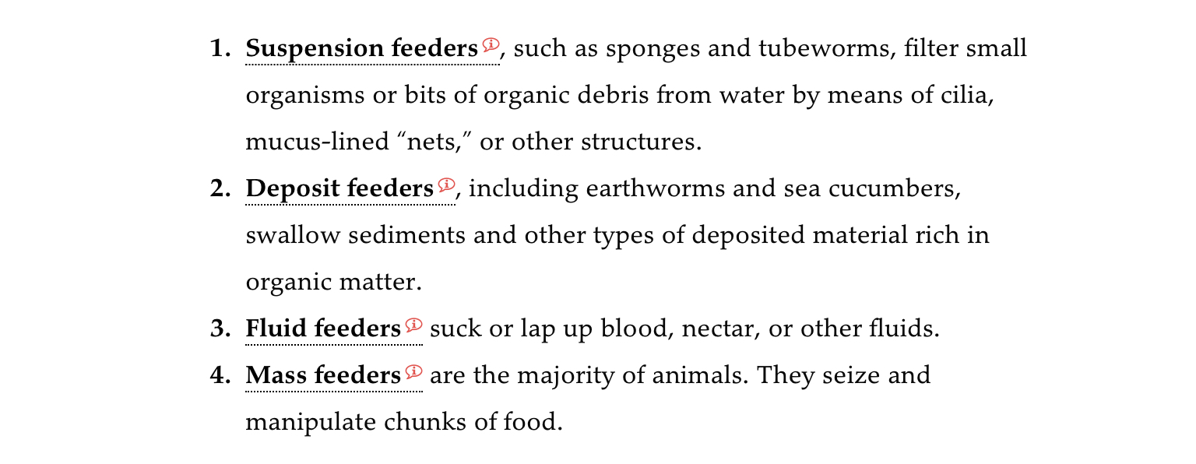
Draw as many type of feeders as you can on your board covering four major strategies?

Slide 18
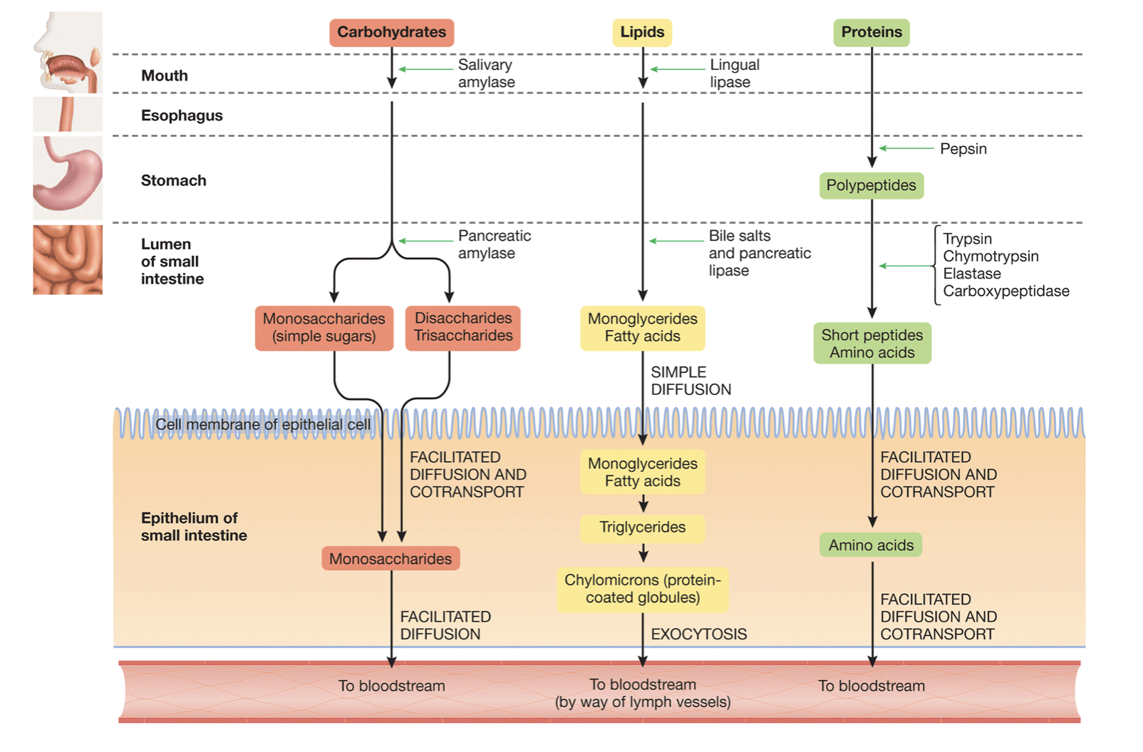
What label should be in the orange box?
a. nitrogens
b. carbohydrates
c. lipids
d. pepsin
Notes:
And oxygen consumpiton – ex surface

Slide 19
What label should be in the orange box?
a. nitrogens
b. carbohydrates
c. lipids
d. pepsin
Notes:
And oxygen consumpiton – ex surface

Slide 20
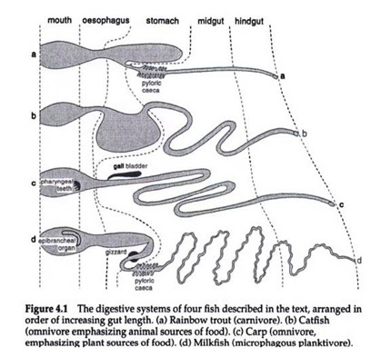
What can you tell me about the diet of each fish?

Slide 21
What can you tell me about the diet of each fish?

Slide 23
Learning objectives:
Summarize how the light-capturing reactions and the Calvin cycle transform light energy to chemical energy.
Describe how ATP and NADPH are produced during the light-capturing reactions of photosynthesis.
Describe the three phases of the Calvin cycle.

Slide 24
1. What is the simplified formula representing photosynthesis?

Slide 25
1. What is the simplified formula representing photosynthesis?

Slide 26
Photosynthesis consists of two linked set of reactions. Draw a flow chart illustrating this process.

Slide 27
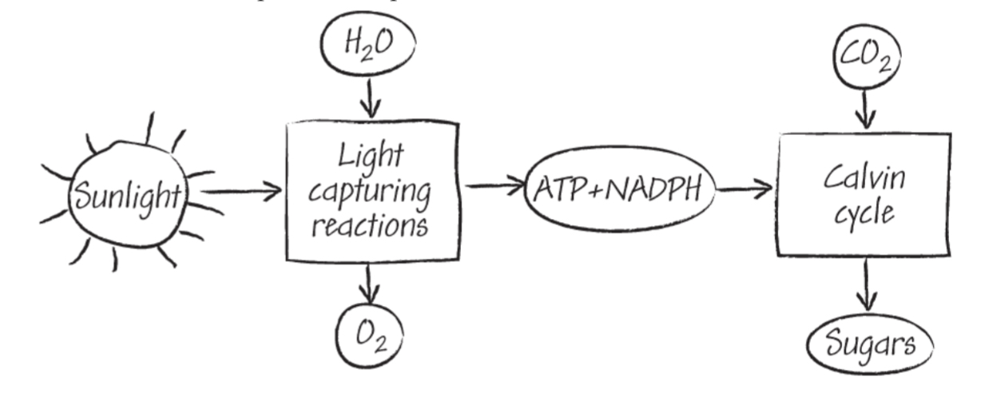
Photosynthesis consists of two linked set of reactions. Draw a flow chart illustrating this process.

Slide 28
During the light-capturing reactions, electrons are promoted to high energy state by light and then transferred through a series of reactions to reduce a …
a. Chloroplast
b. Phosphorylated version of NAD+
c. Sugar
d. Carbon
Notes:
And oxygen consumpiton – ex surface

Slide 29
During the light-capturing reactions, electrons are promoted to high energy state by light and then transferred through a series of reactions to reduce a …
a. Chloroplast
b. Phosphorylated version of NAD+
c. Sugar
d. Carbon
Notes:
Energy released is also used to produced ATP

Slide 30
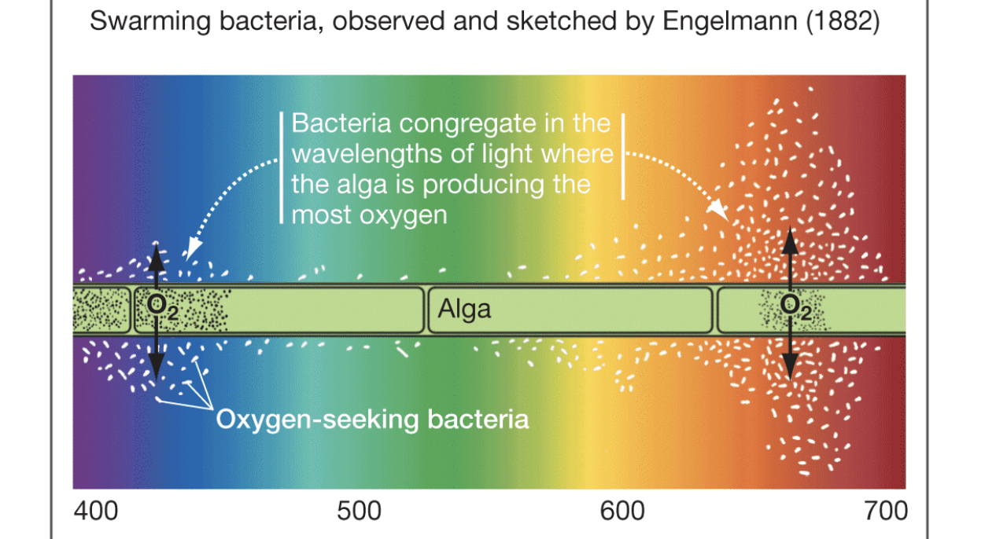
What does this experiment illustrate?
Notes:
Defined as action spectrum. -

Slide 31
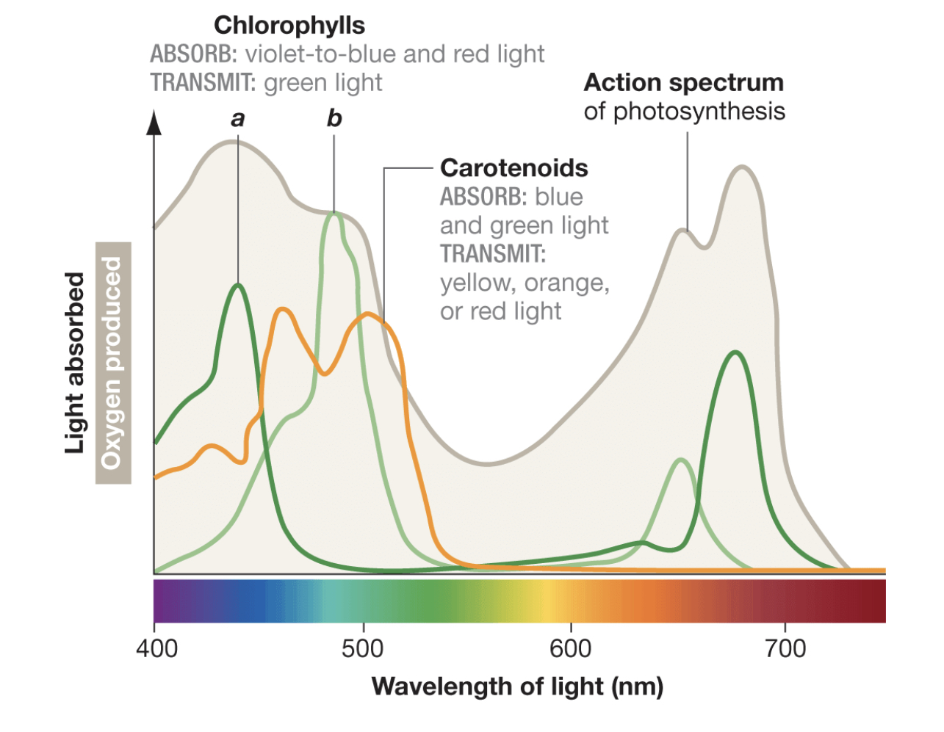
What does this experiment illustrate?
Notes:
Defined as action spectrum. -

Slide 32
Sketch how NADPH and ATP are produced.
Notes:
When chlorophyll in antenna complex hit – one electron to high energy state
In antenna complex excited electrons transmit energy from high to low to reaction center
When energy is transferred to a chlorophyll molecule in the reaction center the excited electron in transferred ……

Slide 33
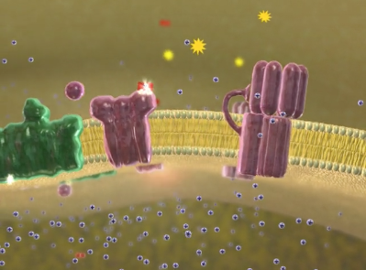
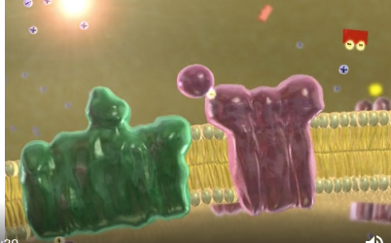
Sketch how NADPH and ATP are produced.

Slide 34
1. What are the three steps of the Calvin Cycle?

Slide 35
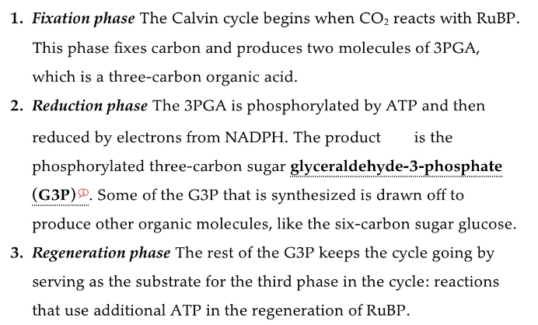
1. What are the three steps of the Calvin Cycle?

Slide 36
1. Can you sketch the steps of the Calvin Cycle?

Slide 37
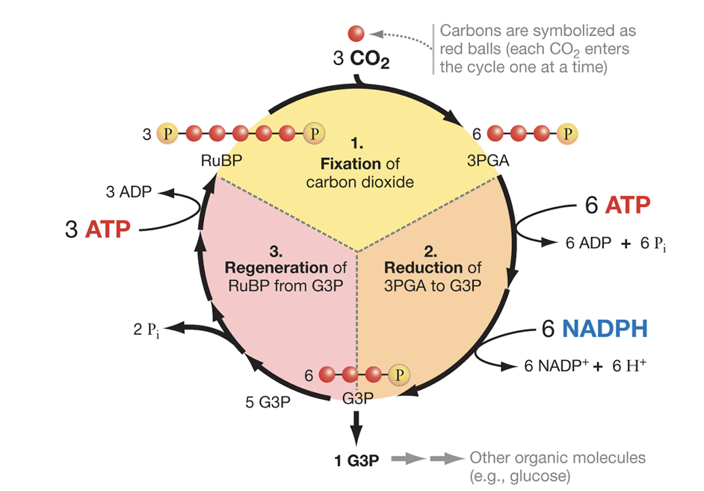
1. Can you sketch the steps of the Calvin Cycle?

Slide 38
1. Describe what might happen to life on Earth if rubisco were suddenly unable to fix oxygen.

Slide 39
1. Describe what might happen to life on Earth if rubisco were suddenly unable to fix oxygen.
CO₂ fixation would stop…
CO₂ would increase rapidly, and the production
of new plant tissue would stop…
Thus most animals would quickly starve to death.

Slide 40
1. Which process in plants generates the most ATP for driving cellular activities, photosynthesis or cellular respiration? Explain.

Slide 41
1. Cultures of microalgae is commonly grown in three dimensional structures like these tubes. Why would reducing the antenna complex benefit the culture when grown in full sunlight?

Slide 42
Design a molecular based experiment to determine to what degree an organisms uses light or methane?
How might these data relate to adaptation, acclimation, acclimatization?

