Slide 2
1. Grab a white board and sit in groups of 5
2. Question of the day is: What is something that is not clear or something that could be be more accessible in terms of course logistics?
3. Do this separately then compare and rank.

Slide 3
Learning objectives:
• Describe and compare the structure and function different body forms.
• Understand how adaptation occurs
• Describe how body size affects physiology
• Be able to explain what homeostasis is and how it is regulated.

Slide 4
What is acclimitization?

Slide 5
What is adaptation?

Slide 6
What is an example of the concept that form facilitates function?

Slide 7
What is metabolic rate?

Slide 8
What is metabolic rate?
… overall rate of energy consumption

Slide 9
What is metabolic rate?
… overall rate of energy consumption
How does animal size influence this?
Notes:
Big animals have to have low BMR p
Otherwise surface area would fail to keep up with metabolic needs.

Slide 10
Which of the following does NOT relate to the hypothesis regarding the differences in mass specific BMR?
a. Fur density
b. Food digestion
c. Delivery of nutrients to tissues
d. Removal of wastes and excess heat
Notes:
And oxygen consumpiton – ex surface

Slide 11
Which of the following does NOT relate to the hypothesis regarding the differences in mass specific BMR?
a. Fur density
b. Food digestion
c. Delivery of nutrients to tissues
d. Removal of wastes and excess heat
Notes:
And oxygen consumpiton – ex surface

Slide 12
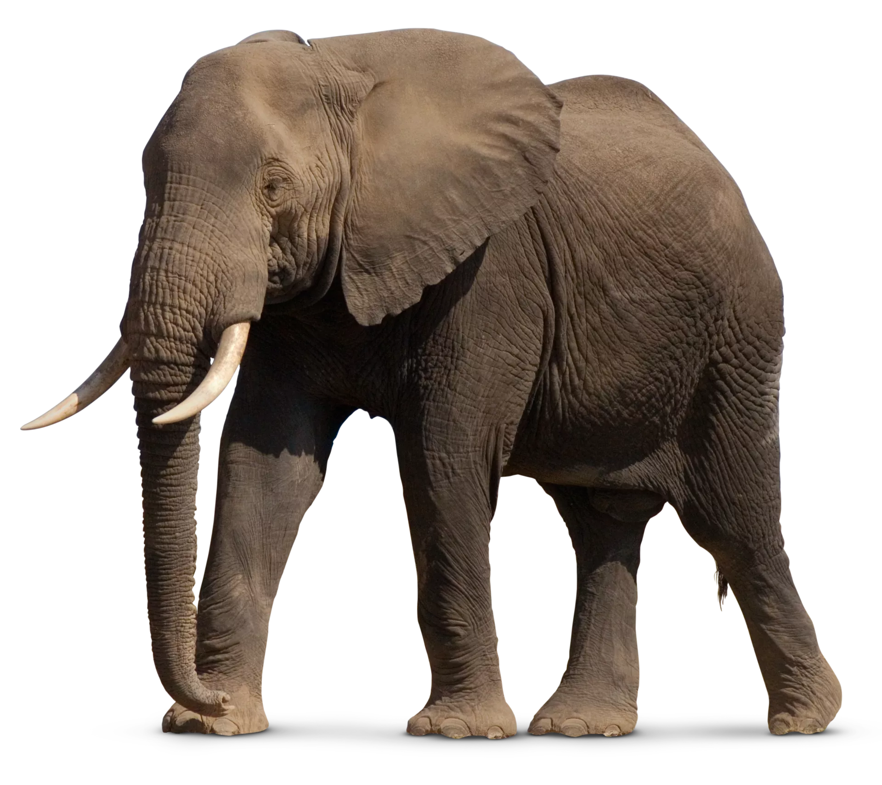
Under what conditions might a organism approaching the size of an elephant have a basal metabolic rate closer to that of an mouse?

Slide 13
Under what conditions might a organism approaching the size of an elephant have a basal metabolic rate closer to that of an mouse?
What factors might contribute most to this?

Slide 14
What is the most common means by which homeostasis is maintained?
a. Organization
b. Negative feedback
c. Responsiveness
d. Positive feedback
e. Differentiation

Slide 15
What is the most common means by which homeostasis is maintained?
a. Organization
b. Negative feedback
c. Responsiveness
d. Positive feedback
e. Differentiation

Slide 16
The three major players in the negative feedback system are?
a. tissue, cell, organ
b. sensor, integrator, effector
c. controller, thermostat, rheostat
d. sensor, set point, recorder

Slide 17
The three major players in the negative feedback system are?
a. tissue, cell, organ
b. sensor, integrator, effector
c. controller, thermostat, rheostat
d. sensor, set point, recorder

Slide 18
1. Consider an aquatic organism that is maintaining homeostasis with regard to pH. How might this occur? What are the sensors, integrator, and effector?

Slide 19
1. Consider an aquatic organism that is maintaining homeostasis with regard to pH. How might this occur? What are the sensors, integrator, and effector?
How could this be improved?

Slide 21
Learning objectives:
• Understand how organisms convey information to the brain.
• Describe the different types of sensors.
• Describe how and why different organisms sense pressure
• Explain how light information can change membrane potential

Slide 22
1. What are the different types of sensory receptors?

Slide 23
What are the different types of sensory receptors?
Nociceptors - sense harmful stimuli such as tissue injury
Thermoreceptors - detect changes in temperature
Mechanoreceptors - respond to distortion caused by pressure
Chemoreceptors - perceive the presence of specific molecules
Photoreceptors - respond to particular wavelengths of light
Electroreceptors - detect electrical fields
Magnetoreceptors - detect magnet fields

Slide 24
Sketch a the mammalian eye including and inset of the mechanisms by which light information is conveyed to the brain?

Slide 25
Sketch a the mammalian eye including and inset of the mechanisms by which light information is conveyed to the brain?

Slide 26
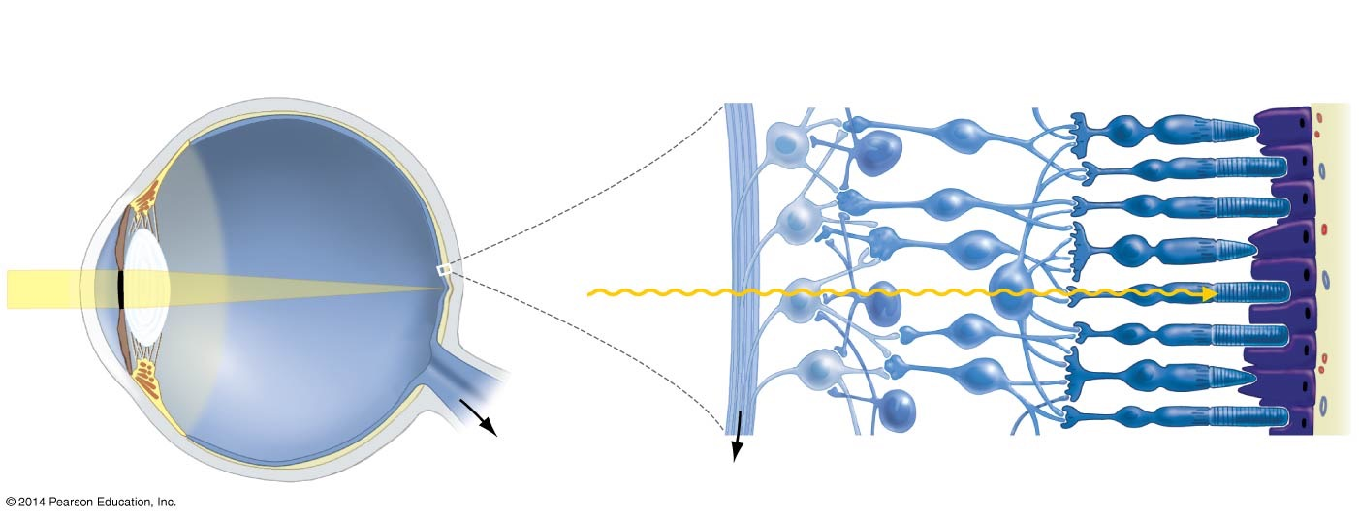
Sketch a the mammalian eye including and inset of the mechanisms by which light information is conveyed to the brain?

Slide 27
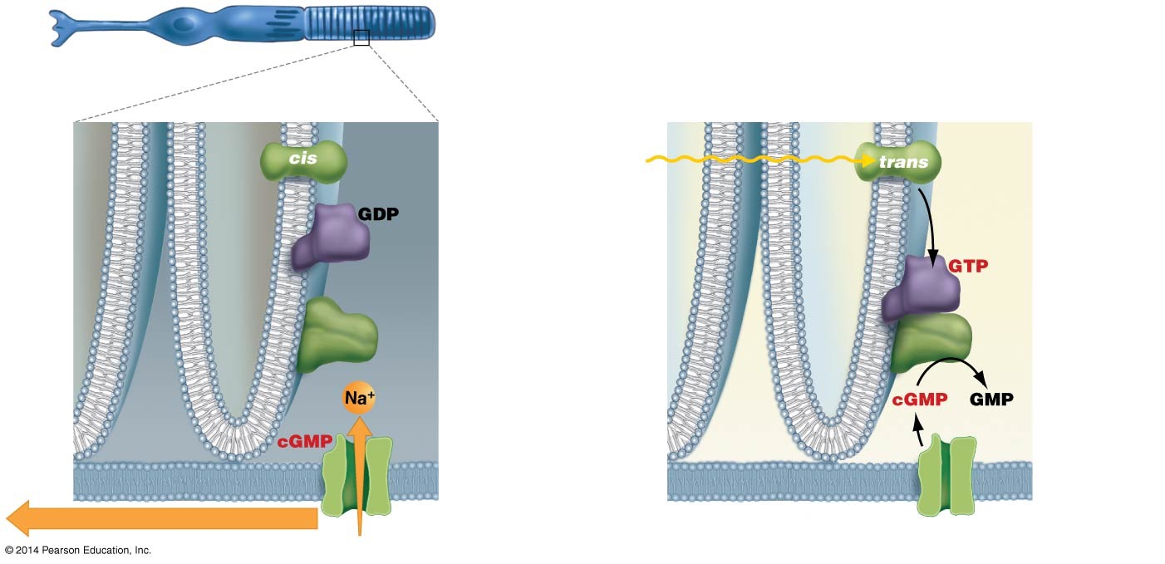
Sketch a the mammalian eye including and inset of the mechanisms by which light information is conveyed to the brain?
Notes:
Figure 47.13 A Signal-Transduction Pathway Connects Light Absorption to Changes in Membr
ane Potential.
In vertebrates, the molecular basis of vision is a shape change in retinal that closes ion channels and decreases the amount of neurotransmitter being released to the sensory neuron. In rod cells, electrical activity across the membrane, as well as neu- rotransmitter release, are maximized in the dark. When retinal has not been activated by light, sodium channels in the rod’s plasma membrane are open (FIGURE 47.13a), and entry of sodium continually depolarizes the rod cells. Exposure to light transmits information by inhibiting both processes.
FIGURE 47.13b shows how shutting down happens:
Rhodopsin is activated when light causes retinal to change
shape from the cis to trans conformation.
Rhodopsin activation causes a membrane-bound molecule called transducin to activate the enzyme phosphodiesterase (PDE).
PDE breaks down a nucleotide called cyclic guanosine mo- nophosphate (cGMP) to guanosine monophosphate (GMP).
As cGMP levels decline, cGMP-gated sodium channels in the plasma membrane of the rod cell close.
When sodium channels close, Na+ entry decreases and the membrane hyperpolarizes.

Slide 28
Sketch a hair cell and indicate how pressure information is conveyed to the brain?

Slide 29
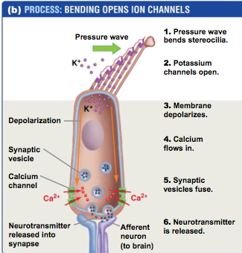
Sketch a hair cell and indicate how pressure information is conveyed to the brain?

Slide 30
Draw the outer, middle, and inner ear of a mammal?

Slide 31
Draw the outer, middle, and inner ear of a mammal?

Slide 32
Draw the outer, middle, and inner ear of a mammal?
What is going on? How does form indicate function?

Slide 33
Design an aquarium based experiment to determine to what degree an aquatic organism uses pressure versus photoreception?

Slide 34
Design a molecular based experiment to determine to what degree an aquatic organism uses pressure versus photoreception?

Slide 35
Design a molecular based experiment to determine to what degree an aquatic organism uses pressure versus photoreception?
How would you expand this plan to make sure you capture all “tiers” of molecular information? (think central dogma)

Slide 36
Design a molecular based experiment to determine to what degree an aquatic organism uses pressure versus photoreception?
How might these data relate to adaptation, acclimation, acclimatization?

