Slide 1
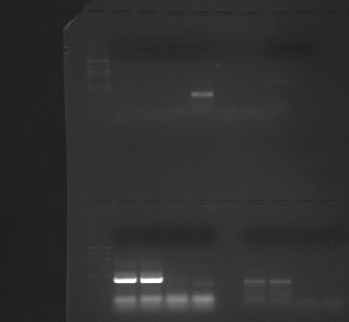
PCR product with 2 µL RNA sample
PCR product with 0 µL sample
(negative control)
500 bp
200 bp

