Slide 1
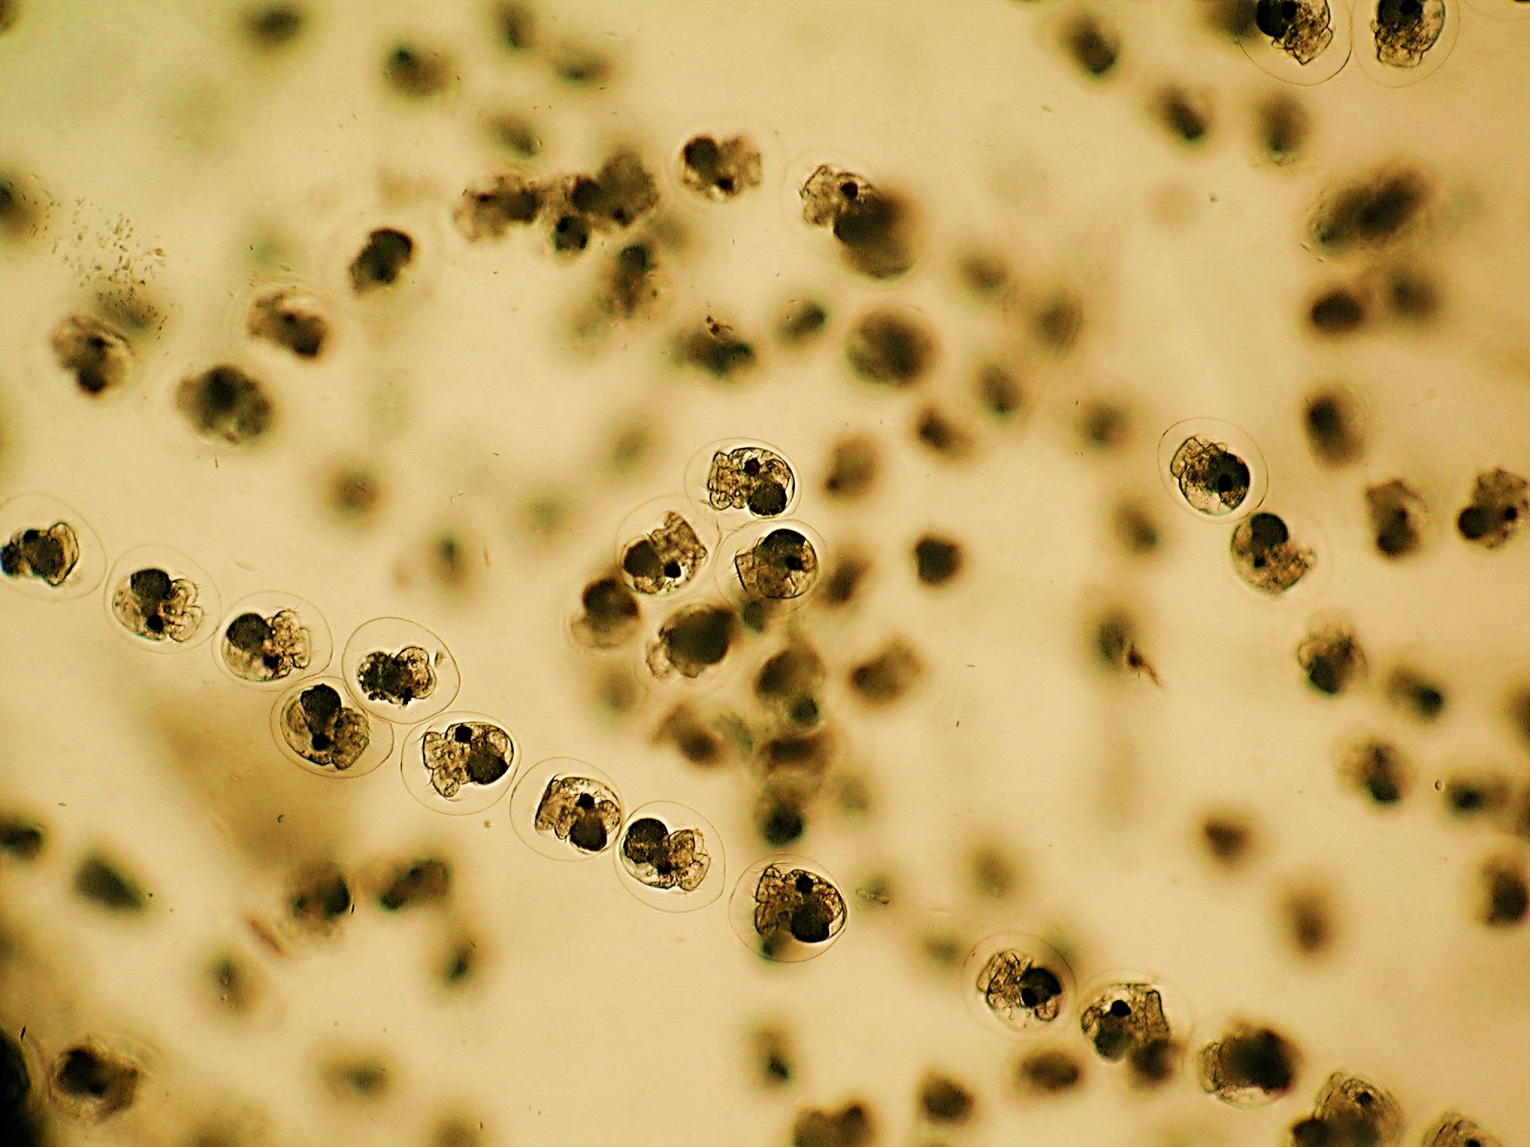
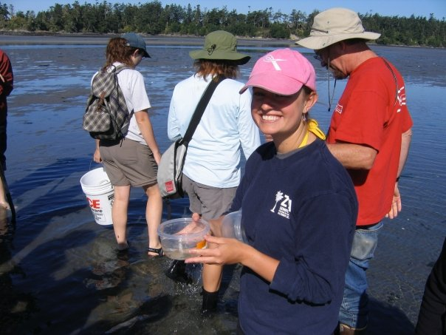
Anti-microbial Activity in Molluscan Egg masses in the San Juan Islands
Anti-microbial Activity in Molluscan Egg masses in the San Juan Islands
Samantha Smoot
College of Charleston
Graduate Program in Marine Biology
scsmoot@gmail.com
Advisor: Robert Podolsky
BENTHIC ECOLOGY MEETING 2012

Slide 2
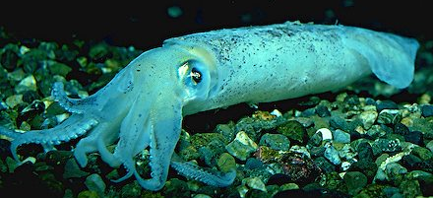
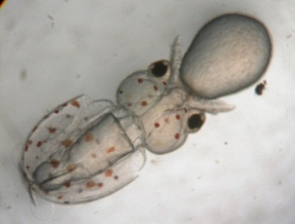
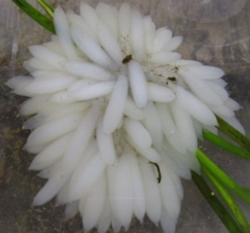
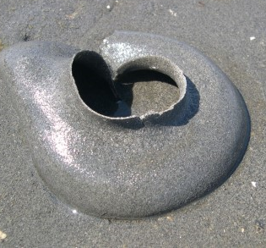
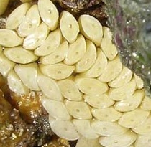
Invertebrate Egg Masses
and Capsules
Common reproductive strategy among inverts
Rich in polysaccharides and proteins
Highly vulnerable to infection due to composition and sessile nature
Molluscan Life cycle
Fertilization

Slide 3
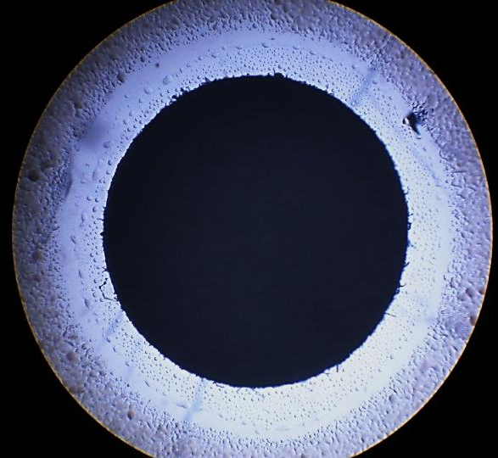
Antimicrobial Chemical Defense
Found in molluscs, annelids, nematodes, arthropods
79% of 41 species of molluscan and annelid egg masses displayed activity against a wide-range of bacteria (Benkendorff 2001)
Bacterial Lawn
Zone of Inhibition
Disk with Egg Mass Extract

Slide 4
Ecological Questions
Ecological Questions
Does the anti-microbial activity within egg masses vary ….
…across habitats?
…when laid on different substrates?
…across different species found in the San Juan Islands?

Slide 5
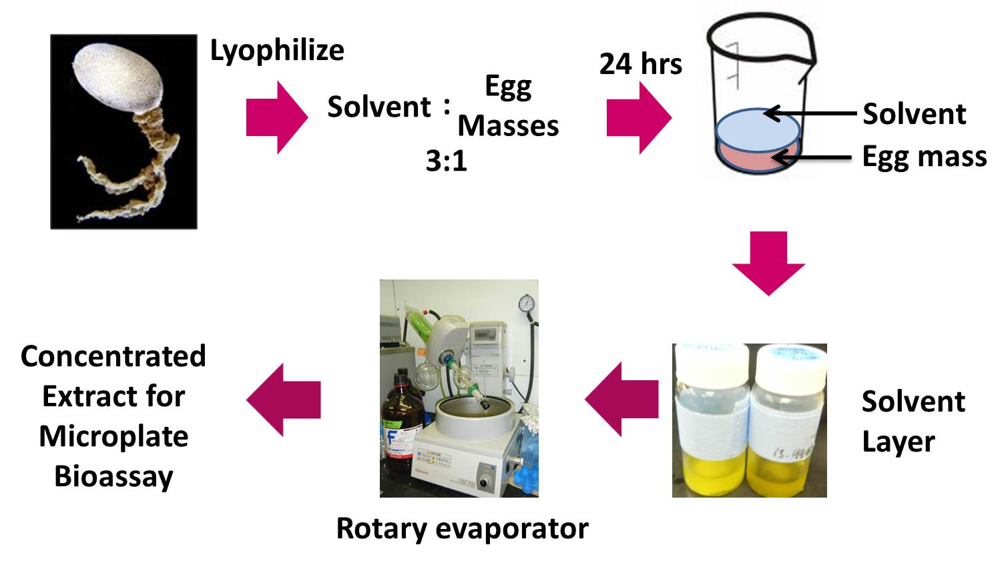
Methods: Extraction
(EtOAc or MeOH)
Protocol adapted from Benkendorff et al, 2001

Slide 6
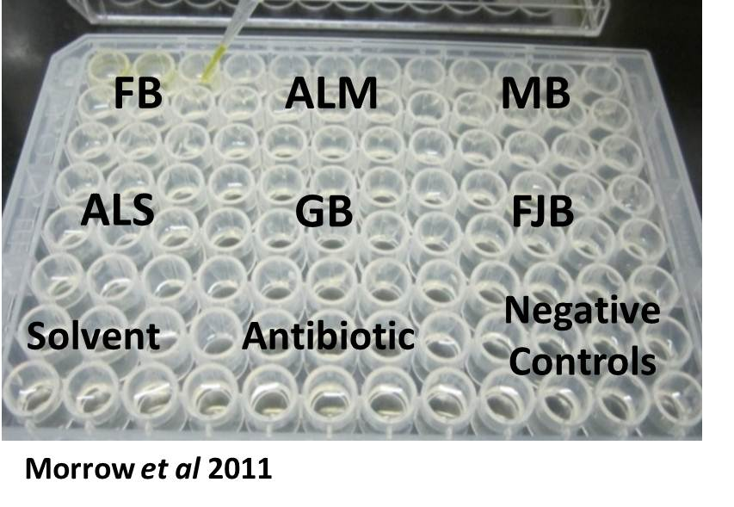
Methods: Microplate Assay
Absorbance (@590 nm) quantifies bacterial count
Higher absorbance= more bacterial growth + lower inhibition
Bacterial Targets:
Bacillus subtilis
Vibrio harveyi
Environmental isolates (3)
Pseudoaltermonas
Micrococcus
Sulfitobacter

Slide 7
Road Map
Chapter 1: Plasticity of anti-microbial activity in egg masses in response to habitat variation in sediment characteristics and microbial load
Chapter 2: Variation in egg masses of Haminoea vesicula as a consequence of deposition on different substrates
Chapter 3: Anti-microbial activity of molluscan egg masses in the San Juan Islands, WA

Slide 8
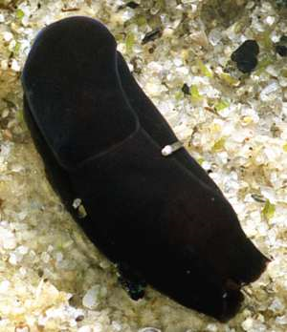
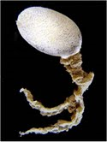
PLASTICITY OF ANTI-MICROBIAL ACTIVITY IN EGG MASSES IN RESPONSE TO HABITAT VARIATION IN SEDIMENT CHARACTERISTICS AND MICROBIAL LOAD
Melanochlamys diomedea
Small Opisthobranch (1 cm)
Sandy tidal flats
Range CA to S. Alaska
Reproduction during late spring and summer
Development within benthic egg mass

Slide 9
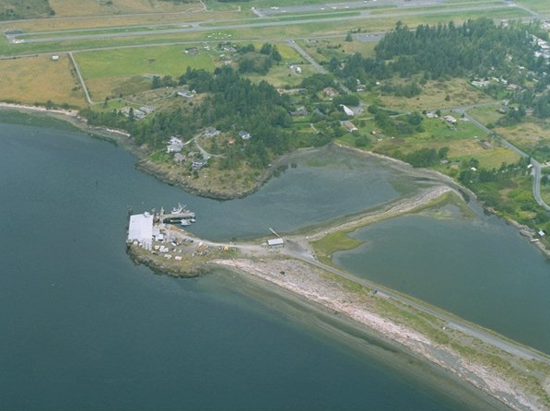
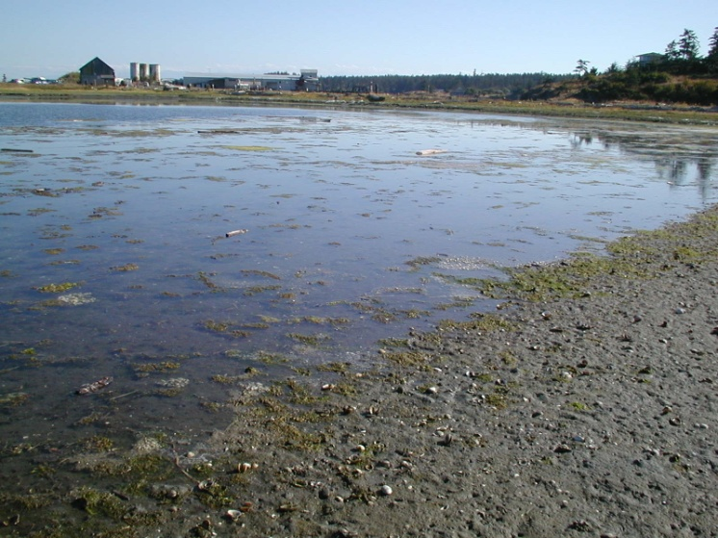
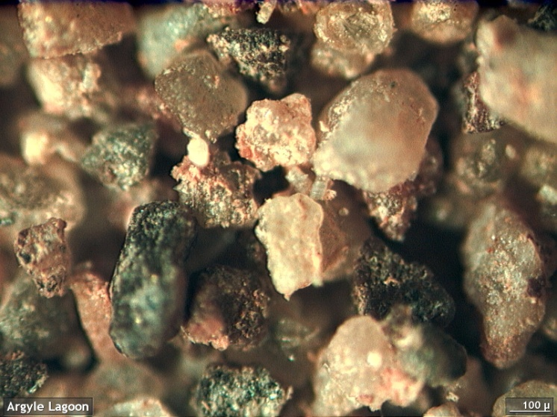
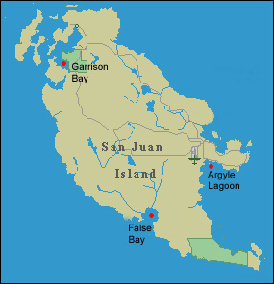
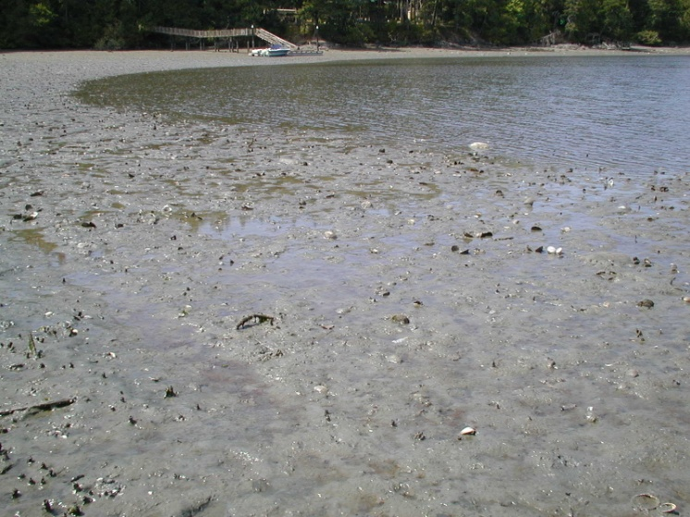
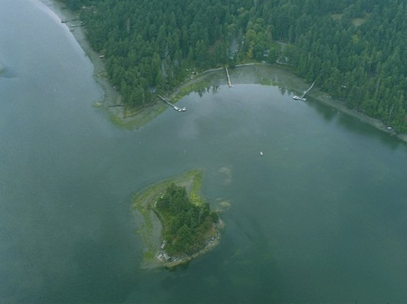
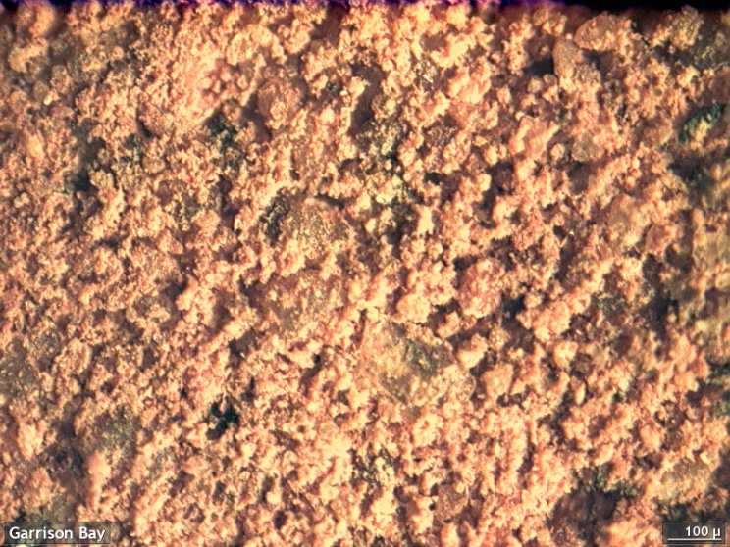
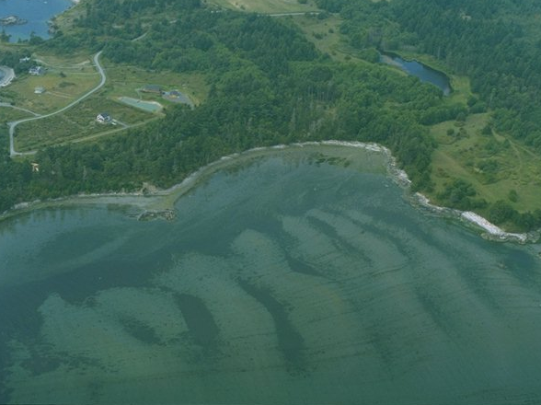
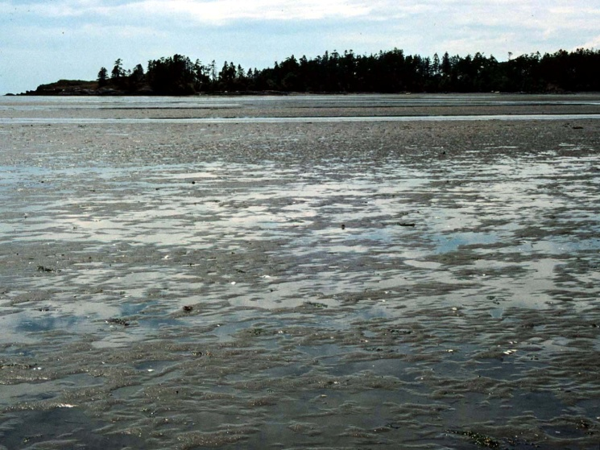
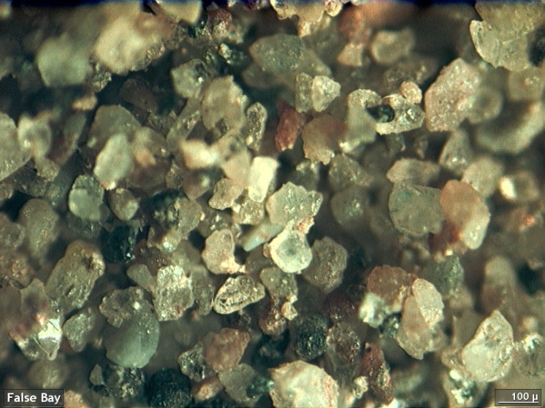
Variation among soft sediment habitats
Mitchell
Bay
4th of
July
Beach

Slide 10
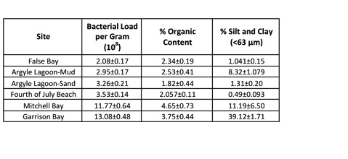
Ch 1 Results: Sediment Characteristics
F_{3,30}=189.63, p=2.2e⁻¹⁶
F_{5,12}=6.4368, p=0.004
F_{5,12}=28.419, p=2.94 e⁻⁰⁶

Slide 11
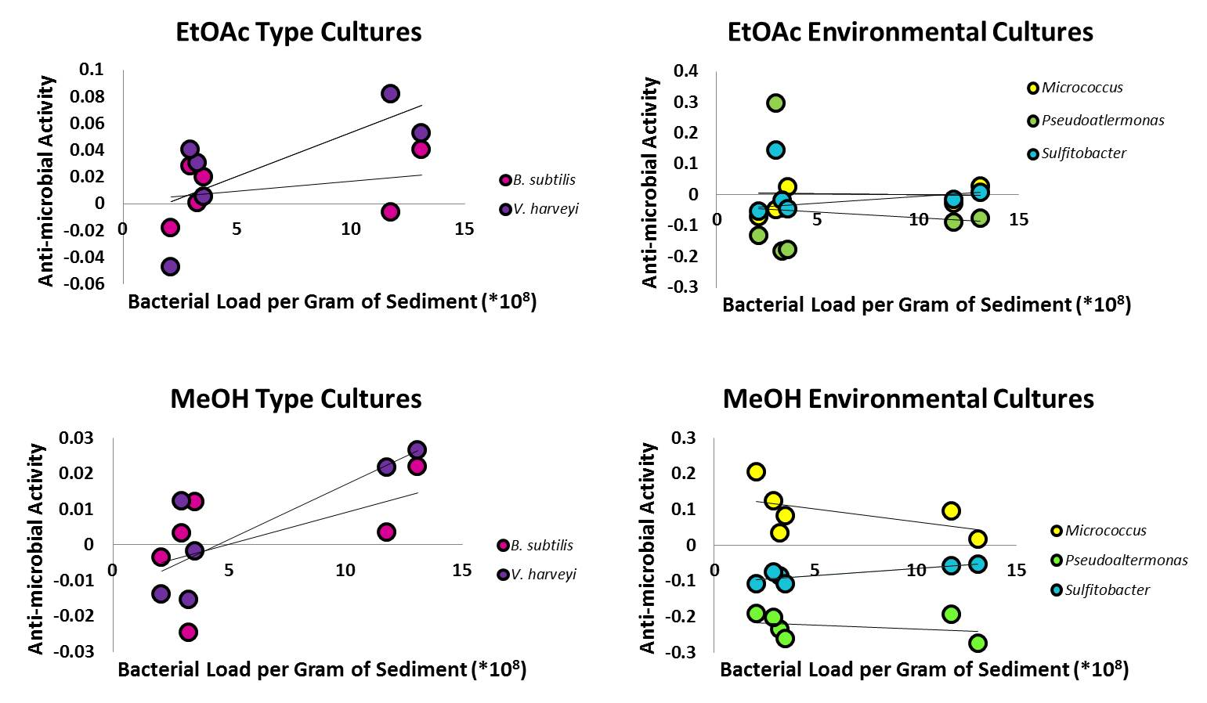
Ch 1: Anti-microbial Activity by Site

Slide 12
Road Map
Chapter 1: Plasticity of anti-microbial activity in egg masses in response to habitat variation in sediment characteristics and microbial load
Chapter 2: Variation in egg masses of Haminoea vesicula as a consequence of deposition on different substrates
Chapter 3: Anti-microbial activity of molluscan egg masses in the San Juan Islands, WA

Slide 13
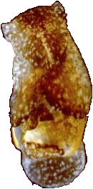
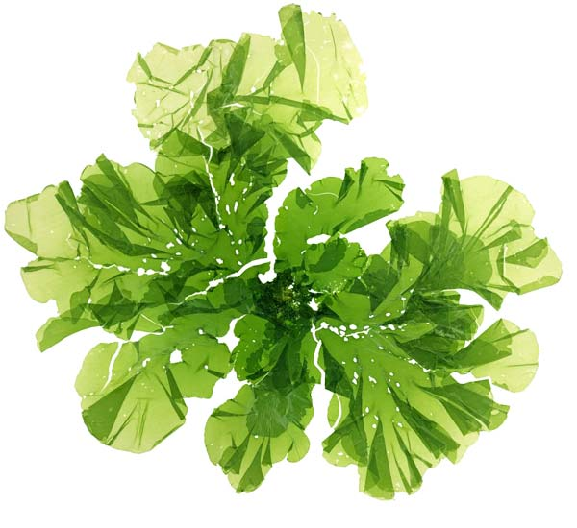
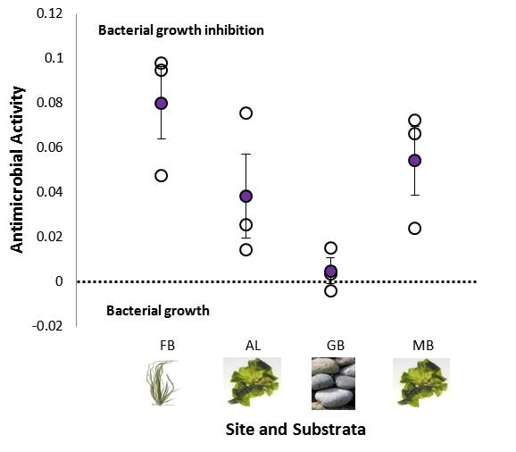
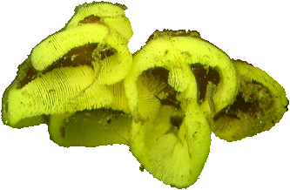
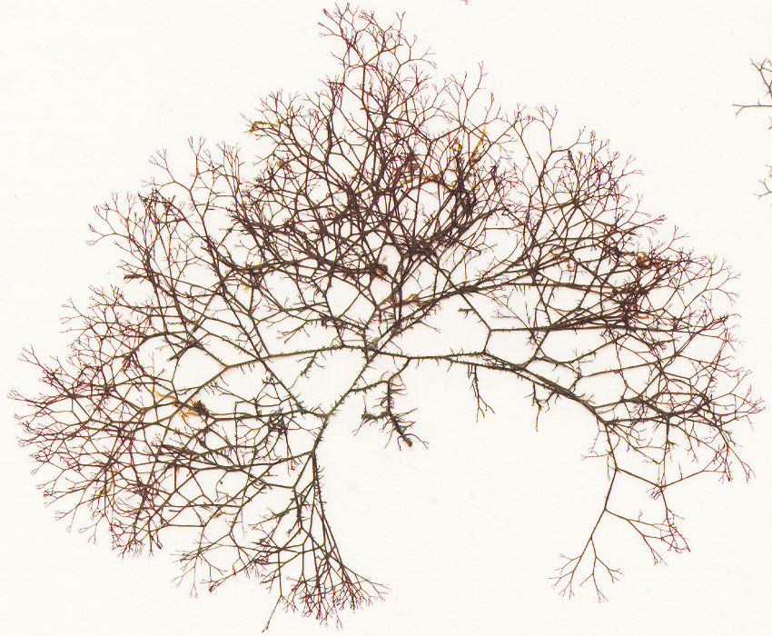
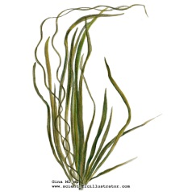
Ch. 2 Study System: Haminoea vesicula
Ulva lactuca
Anti-microbial activity of EtOAc extracts against B. subtilis (2010)
Bubble snail
Ceramium pacificum
Zostera marina
Site and Substrate

Slide 14
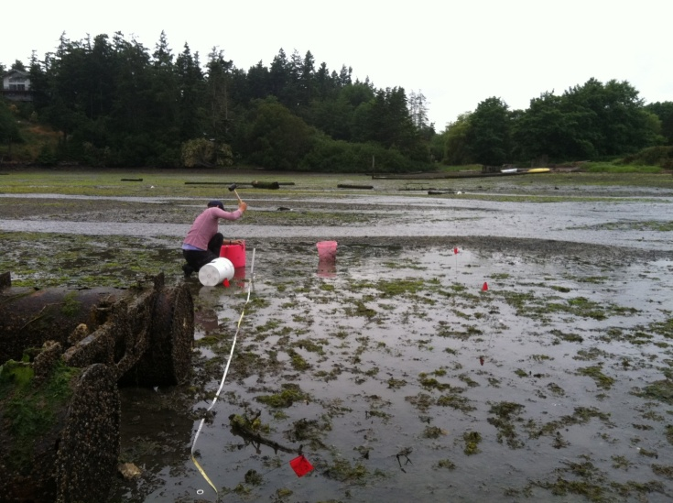
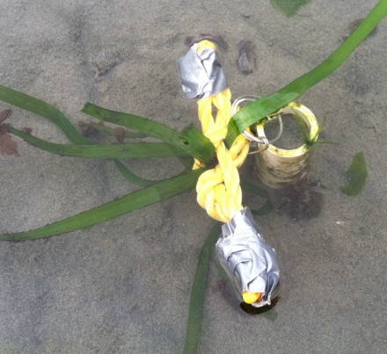
Ch. 2 Field and Laboratory Experiments
Field and laboratory experiments examining effects of substrate and site

Slide 15
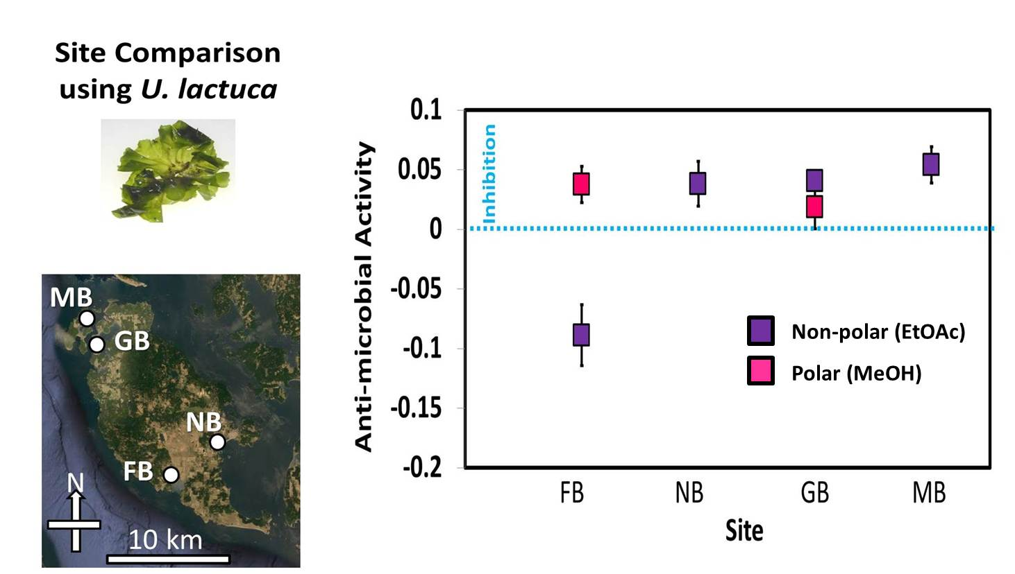
Site Comparison Results

Slide 16
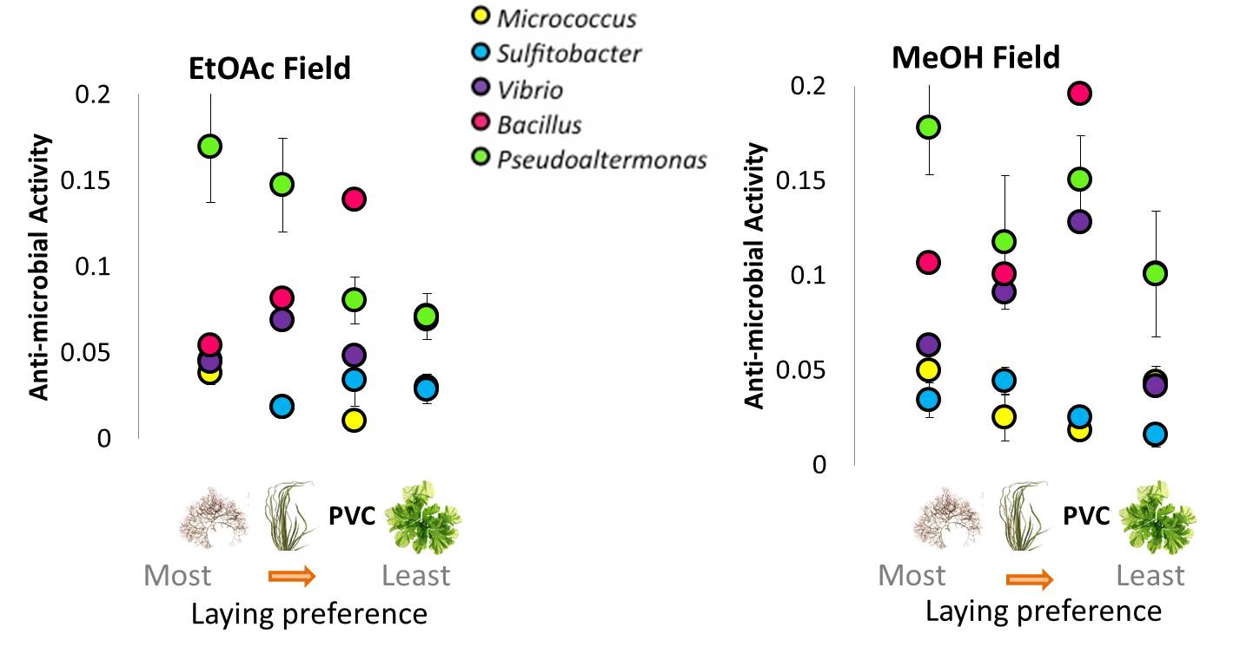
False Bay Substrate Comparison Results

Slide 17
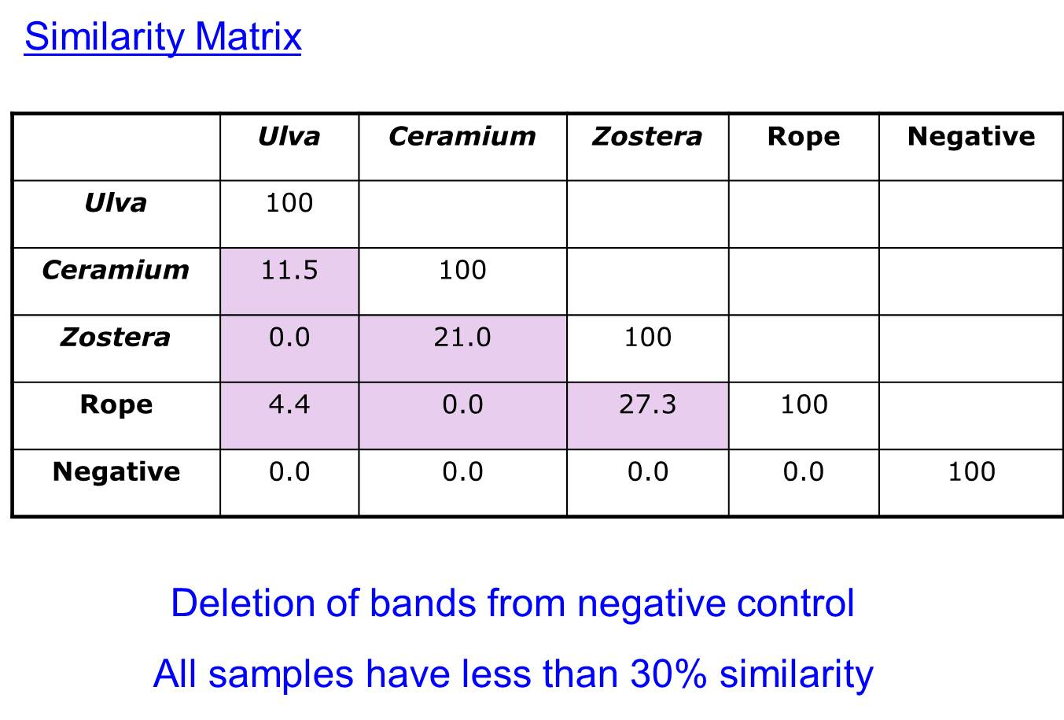
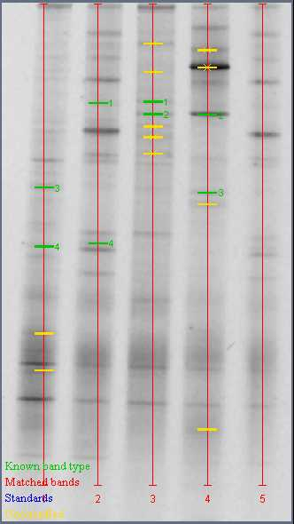
Preliminary Bacterial Communities within Egg Masses on Different Substrates (DGGE)
Rope
-
*Only n=1

Slide 18
Road Map
Chapter 1: Plasticity of anti-microbial activity in egg masses in response to habitat variation in sediment characteristics and microbial load
Chapter 2: Variation in egg masses of Haminoea vesicula as a consequence of deposition on different substrates
Chapter 3: Anti-microbial activity of molluscan egg masses in the San Juan Islands, WA

Slide 19
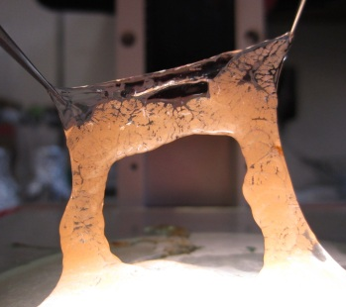
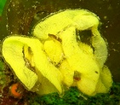
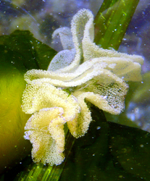
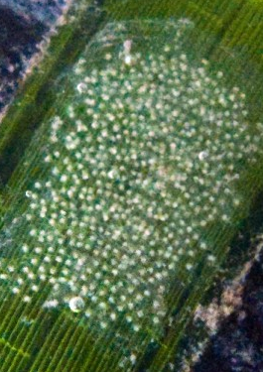
Anti-microbial Activity by Species

Slide 20
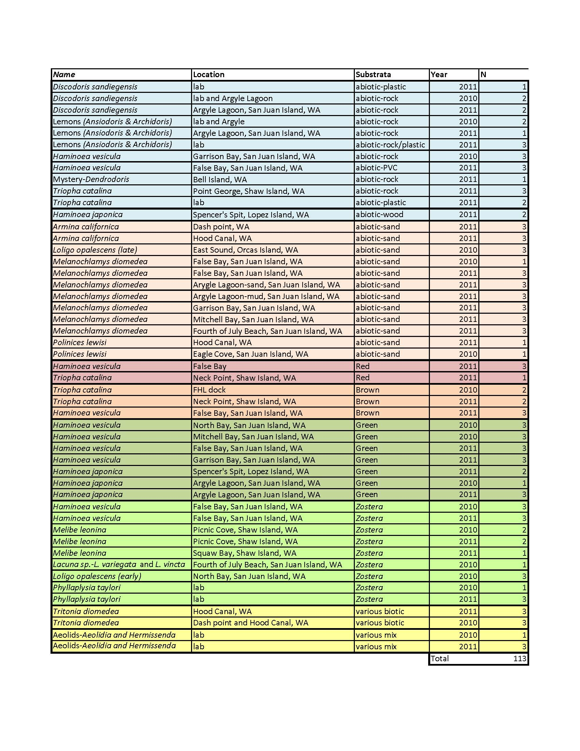
Anti-microbial Activity by Species

Slide 21
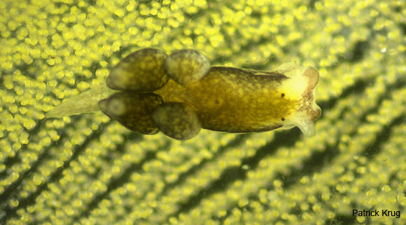
Other projects
M. diomedea development stages: anti-microbial and DGGE
Olea hensineensis with Yasmin Von Dassow
Anti-microbial identification with Jack Bell
Ulva and Haminoea experiments with Charley O’Kelly
Pat Krug

Slide 22
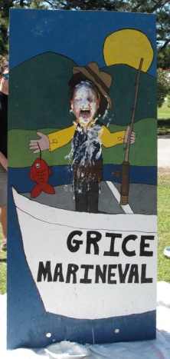
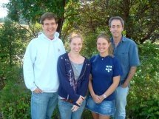
Acknowledgements
Committee Members:
Craig Plante
Erik Sotka
Karen Burnett
Grice Marine Lab
UW Friday Harbor Labs:
UW Faculty and Staff
FHL Divers
Students (2009, 2010, 2011)
Podolsky and Plante Labs:
Daniel Fernandes
Diego Castro
Gabe Segerra
Suzanne Kacenas
Whitney Hook
Vanessa Bezy
Shannon Hoy
Funding Sources:
Joanna Deepwater Foundation Scholarship 2011-2012
FHL Richard and Megumi Strathmann Fellowship 2011
FHL Patricia Dudley Scholarship 2010
CofC Presidential Summer Research Scholarship 2010-2011
NSF OCE-0621467 to RDP
CofC graduate and teaching assistantships
Method Development:
Kathleen Morrow (JCU-AIMS)
Jonathan Craft (JCU-AIMS)
Nat Johnson (MUSC)
Tricia Roth (CofC)
Natasha Sharp (CofC)

Slide 23
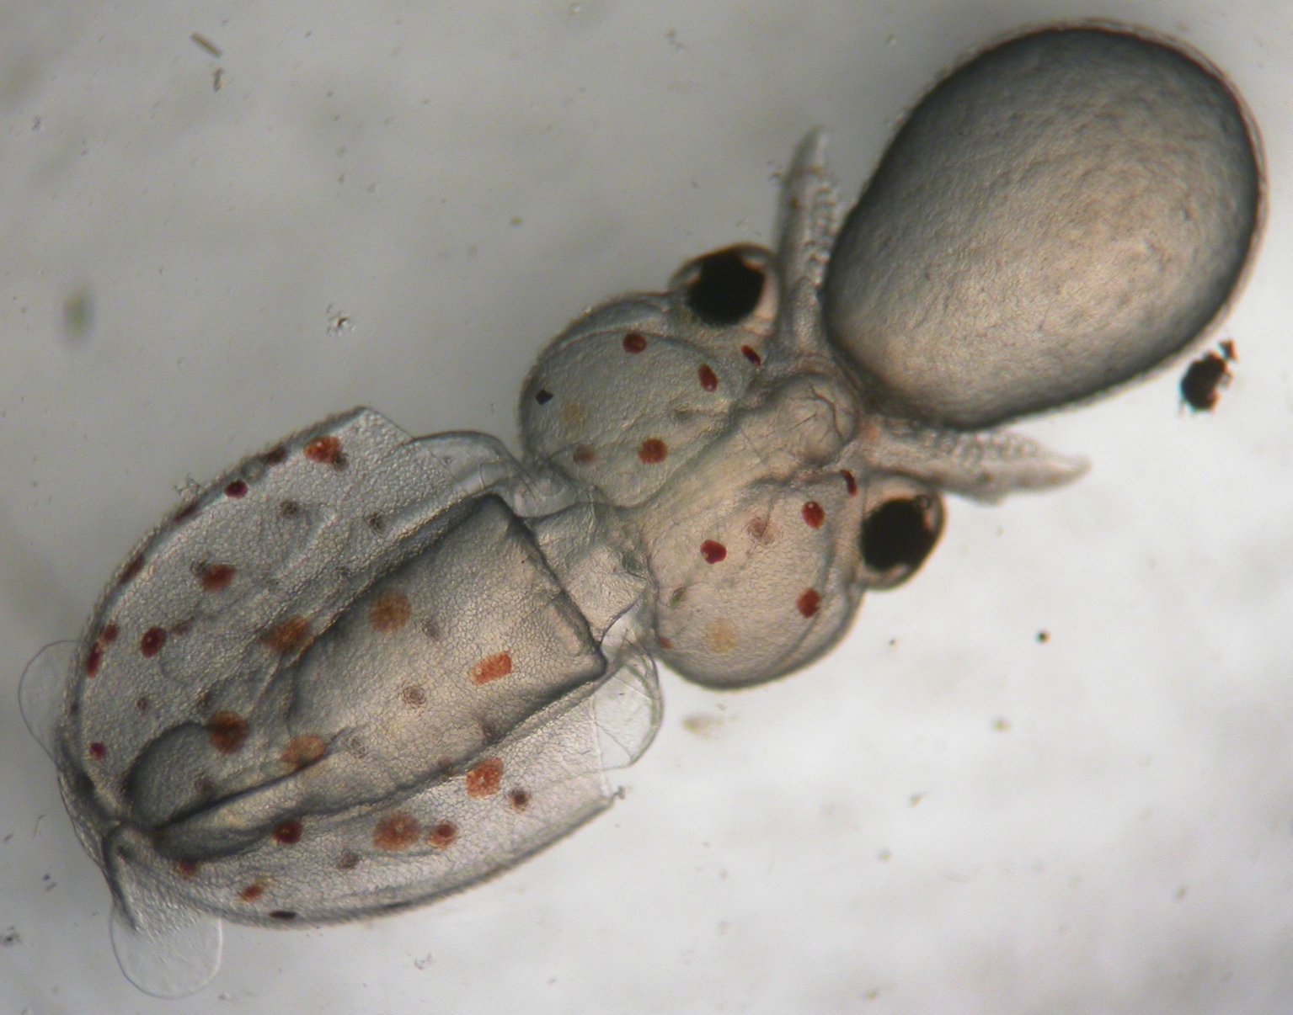
Thank you!

Slide 24
METHODS SLIDES (after presentation)

Slide 25
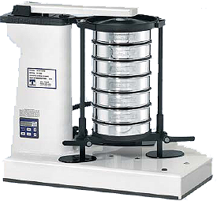
Methods: Sediment Characteristics
Sediment grain size: percent silt and clay (<63 µm)
Separated by grain size using a RoTap sorter
Organic Content
Sediment dried and ashed

Slide 26
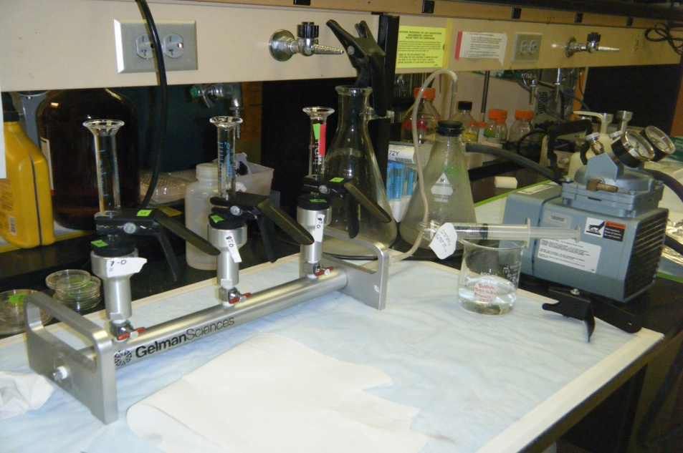
Methods: Bacterial Load
Bacterial Load
Sediment samples were fixed, sonicated, filtered, and stained with SybrGold for bacteria counts.

Slide 27
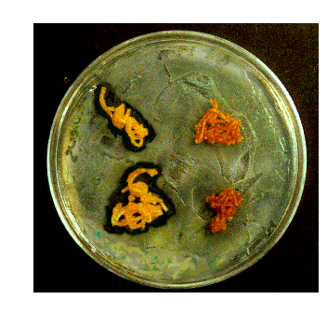
Freshly laid vs. late stage egg masses
Freshly laid Whelk
Egg mass
Late stage
Egg Masses
Benkendorff 2001

