Slide 1
Alki Field Trip
Meet at FTR Parking lot at 8:45 am.
Leave at 9 am.
Leave Alki between 1 and 2 pm.
Parking Free in FTR parking on Sundays
Bring Worksheets!

Slide 2
Crustacea: Senses, Development and more Taxonomy
Notes:
2

Slide 3
Crustacean Senses
Mechanoreception
  Touch, “hearing,” proprioception
  Proprioception: different from other senses because it provides internal feedback – i.e. limb position, movement, cuticular stress
Chemoreception
Photoreception
Notes:
3
Proprioception: cuticular stress detectors. Elastic strands connected to cuticle in limbs. Stress to the cuticle (such as movement) will signal the rest of limbs – probably important when trying to coordinate 19 pairs of appendages ☺

Slide 4
Crustacean Sense Organs
Eyes (photoreception)
Setae (Mechanoreception and Chemoreception)
Statocysts (balance)
Notes:
4

Slide 5
Crustacean Eyes
Most crustaceans have two compound eyes
Compound eye
  Independent photoreception unit containing cornea, lens, and cells to distinguish brightness and color
  Ommatidia: single visual unit of compound eye
Naupliar Eye
  Does not form images
  Determines direction of light source
Notes:
5

Slide 6
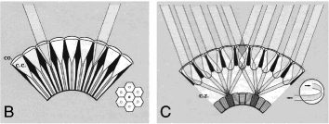
Types of Compound Eyes
Apposition Eye
  Each lens is directly apposed to the rhabdom (photo receptor, light sensing).
  Each lens is very small; each rhabdom receives very little light
  Works best in bright light
Superposition Eye
  Numerous ommatidia combine to direct their light onto a single rhabdom
  Animals can see better in dim light
Notes:
6
Apposition = B, superposition = C

Slide 7
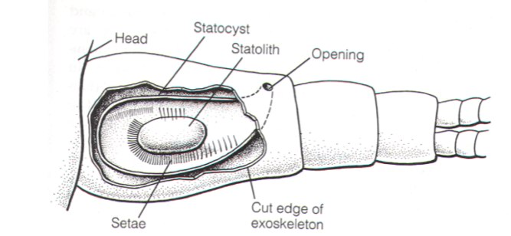
Statocysts
The equilibrium receptor (balance)
Cavity with heavy particle, statolith rests on setae that detect displacement
Notes:
7

Slide 8
Setae
Hair like structures used for mechano and chemo reception (and other)
Extend through exoskeleton—linked to the nervous system
Aesthetascs:
  Patches of sensory setae usually found on first antennae
  Important for locating food and mates
Notes:
8

Slide 9
Senses: in lab
We’ll examine chemoreception by counting antennal flicks before and after adding a food smell to the water
We’ll look at crustacean eyes
Notes:
9

Slide 10
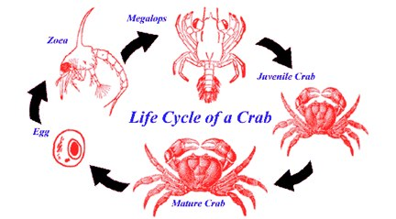
Crustacean Development
Very complicated
Number and type of larval stages varies considerably
Crustacean larvae may look nothing like their parents
Notes:
10
Barnacles have cyprids, copepods have copepodite
, crabs have zoea and megalops

Slide 11
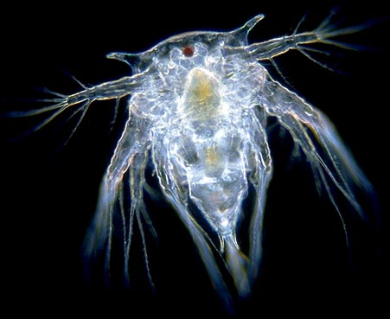
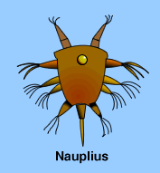
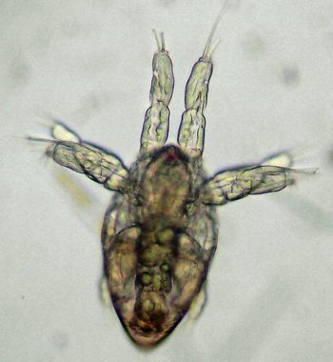
The Nauplius Larva
Characteristic crustacean larval stage: nauplius
The first crustacean larval form
Many pass through this stage in the egg
Has a head and a telson; the thorax and abdomen have not developed yet
One eye
Starts with three appendages but may add appendages after molting
www.mesa.edu
Copepod :www.theseashore.org
Barnacle :www.microscopy-uk.org
Notes:
11

Slide 12
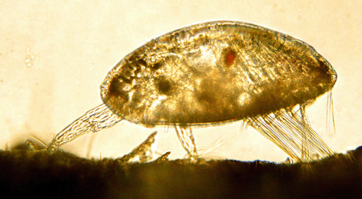
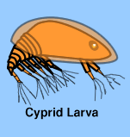
Barnacle Development
Barnacles are highly modified as adults, but the nauplii remain the same
Barnacles spend weeks as a nauplius, undergo 4-6 nauplear molts before molting into a cyprid
Cyprid larva is the final, non-feeding stage before settlement
Cyprid use modified antennae to explore the benthos looking for an appropriate place to settle and metamorphose into an adult
www.mesa.edu
Notes:
12
Looking for: rough surfaces (tactile) and members of their own species (chemosensory)

Slide 13
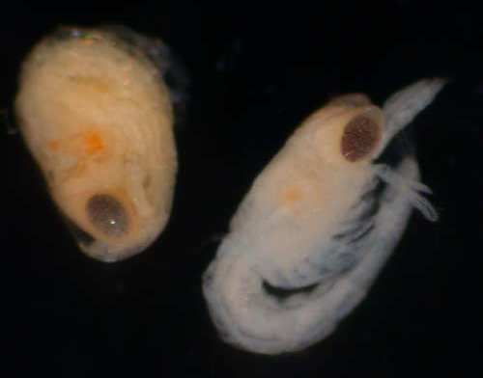
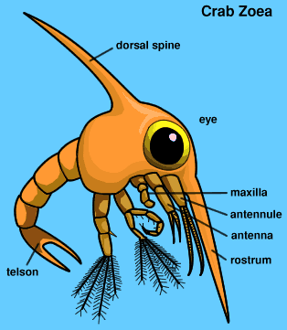
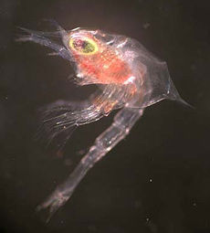
Decapod Development
Decapods usually hatch as a prezoea
  Not a true larval stage—a compact form still partially enclosed by the egg membrane
Once membrane is shed (few minutes) the larva is called a zoea.
The zoea’s spines expand and harden—making it more difficult for predators to swallow!
www.mesa.edu
Blue king crab zoea: wikipedia
Notes:
13

Slide 14
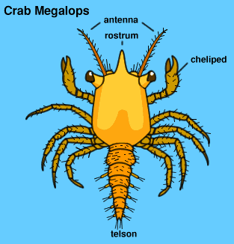
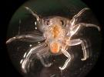
Decapod Development
www.mesa.edu
After weeks or months and several molts as a zoea, decapod larvae molt to the megalops stage
Megalops can both swim and crawl— ideally suited for its sole function of finding good habitat before it settles and becomes a juvenile
www.oceanexplorer.noaa.gov
Notes:
14

Slide 15
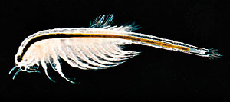
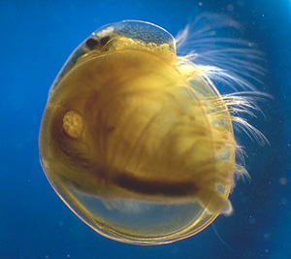
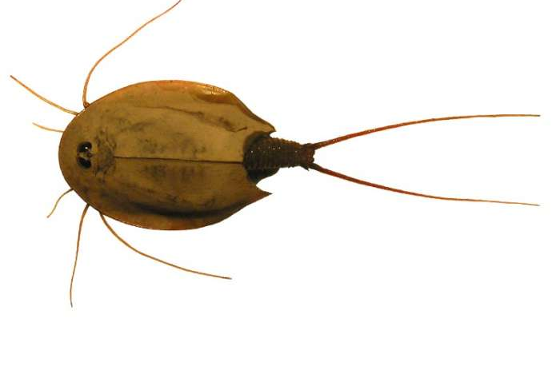
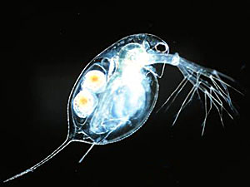
Taxonomy: Subclass Branchiopoda
Many adapted to ephemeral (temporary ponds) or extreme (hypersaline) environments—Maybe because unable to compete or avoid predation in more typical habitat
Many produce cysts that survive long periods of dessication (sea monkeys—add water, hatch instantly)
Characterized by paddle-like thoracic appendages that are used for both locomotion and gas exchange
Composed of 4 orders
  Anostroca
  Notostraca
  Cladocera
  Conchostraca
Notes:
15
Anostraca (brine shrimp), Notostraca (tadpole shrimp or shield shrimp-ephemeral environ ), Cladocera (water fleas, Daphnia-freshwater), Conchostraca (clam shrimp-temp freshwater ponds)

Slide 16
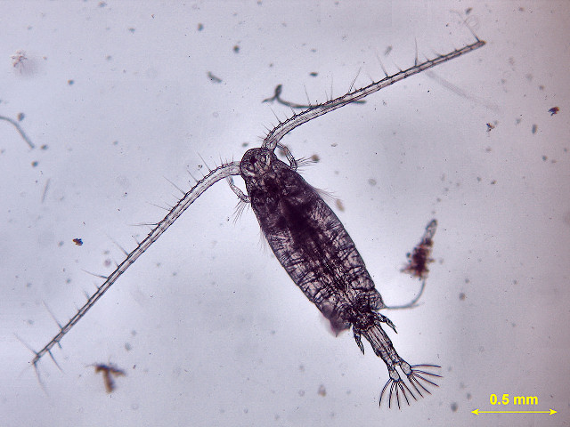
Taxonomy: Subclass Copepoda
Found in fresh, brackish, and marine environments
Found in all marine environments from the surface to depths of over 5000m
Often dominate the marine zooplankton and have incredible ecological importance
May be free living or parasitic. Most free living in one of three orders:
  Calanoida
  Harpacticoida
  Cyclopoida
Notes:
16

Slide 17
Taxonomy: Shrimp and Shrimpy Taxa
The term shrimp has been used for any crustacean that doesn’t look like a crab, lobster or barnacle (i.e. brine shrimp)
You will learn to identify true shrimp (Caridea) from all other “shrimp”
Notes:
17

Slide 18
What we are doing today:
We’re looking at lots of different organisms, mostly under the scopes
Have fun and ask lots of questions!!
What not to do:
  mix fresh and saltwater samples together
  mix live and preserved dishes or pipettes
Notes:
18

