Slide 1
A
ploidy-DML
B
desiccation-DML
C
interaction-DML

Slide 2
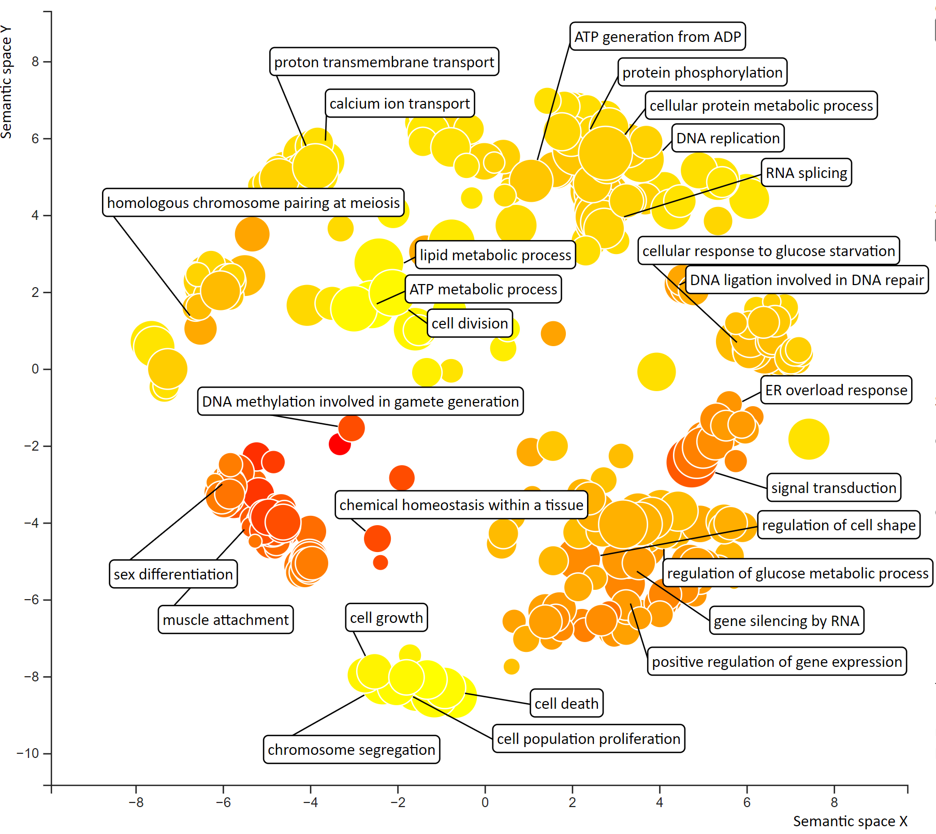
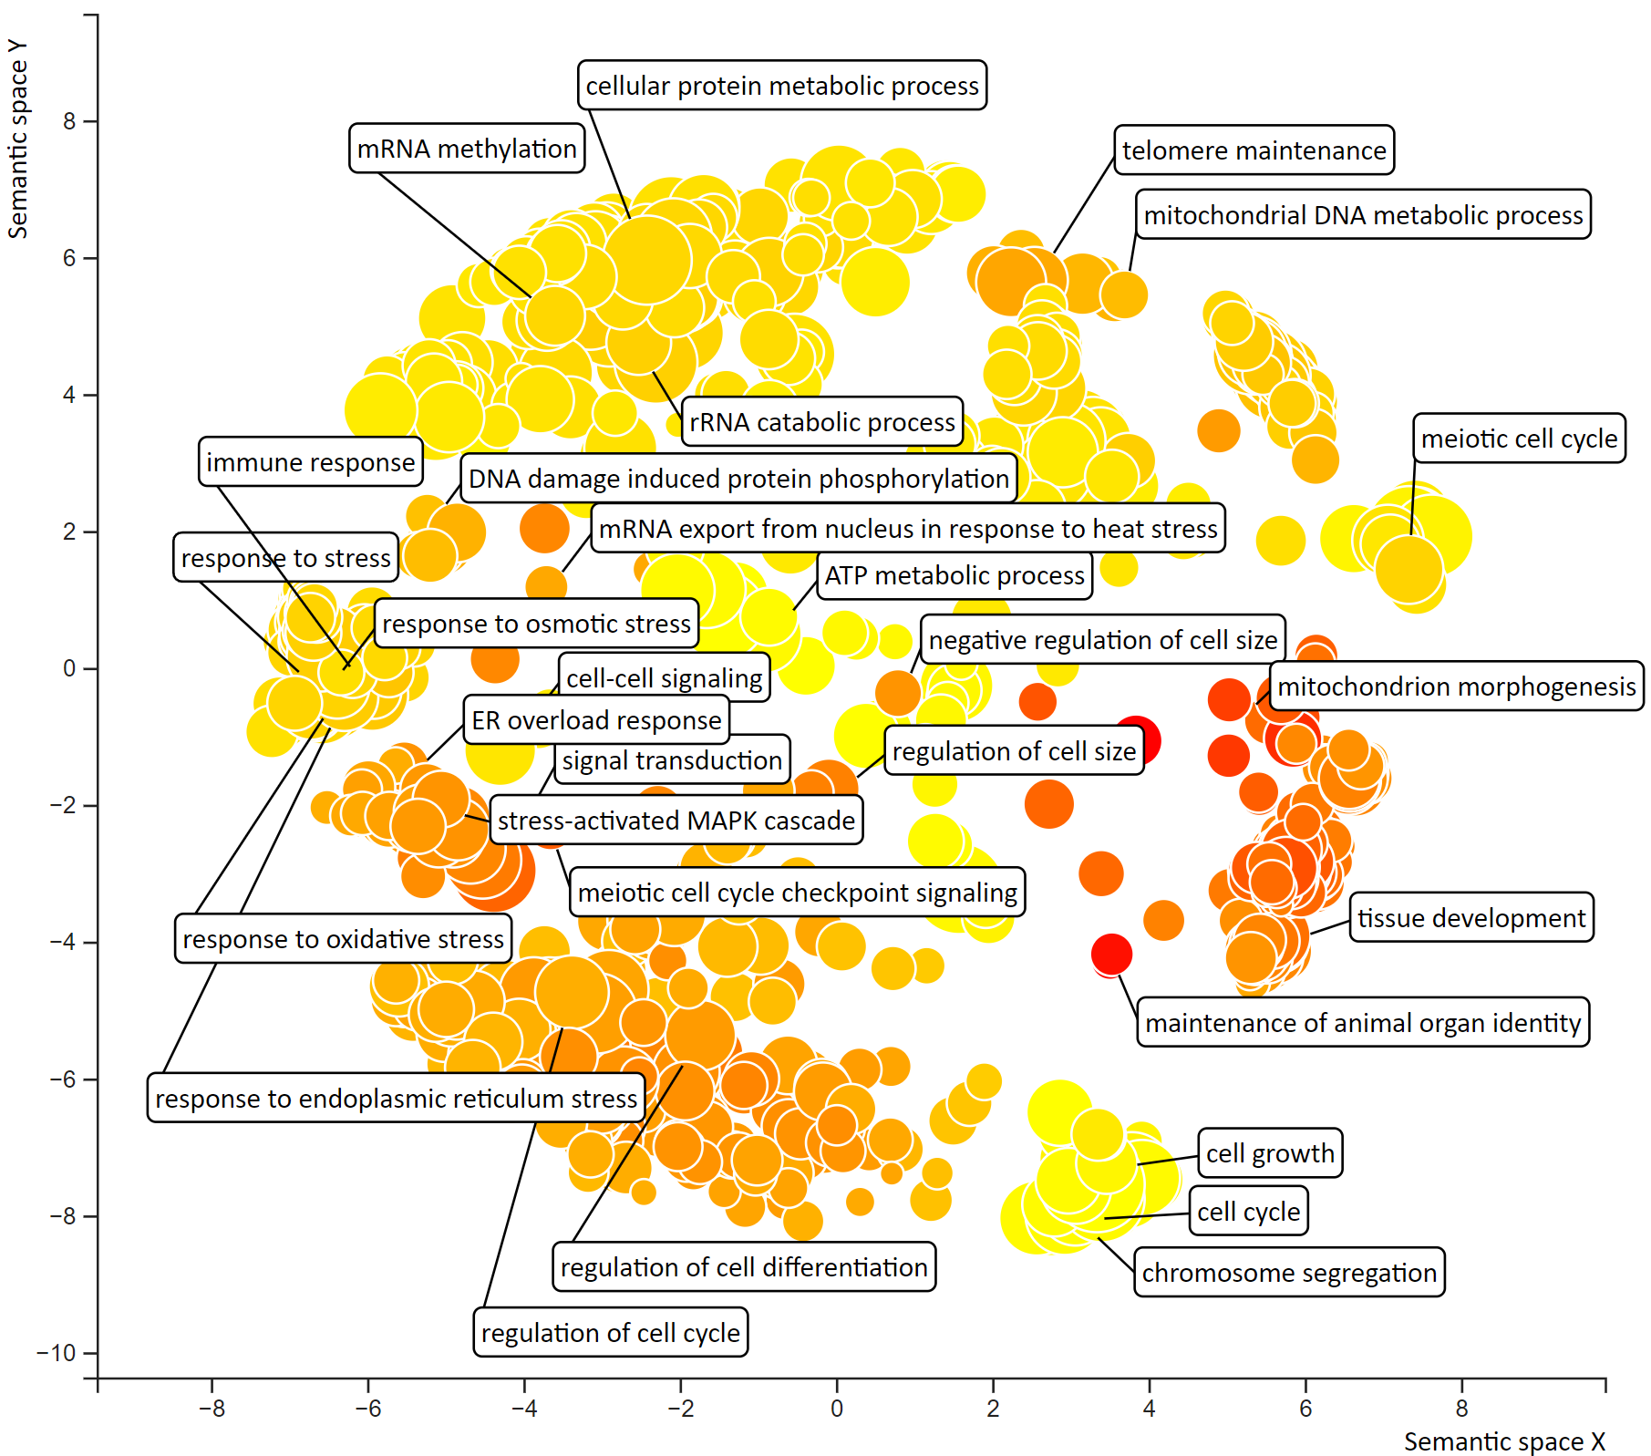
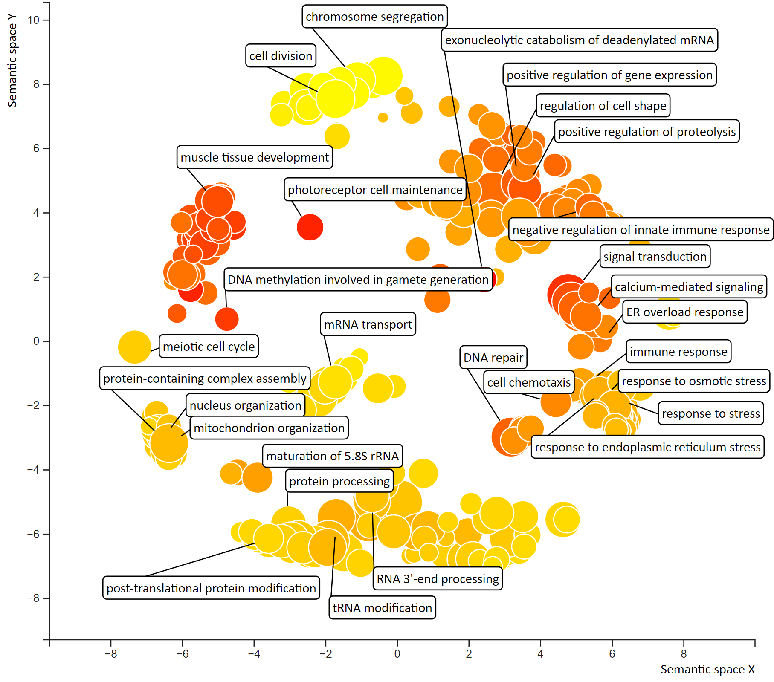
A
ploidy
B
desiccation
C
interaction

