Slide 1
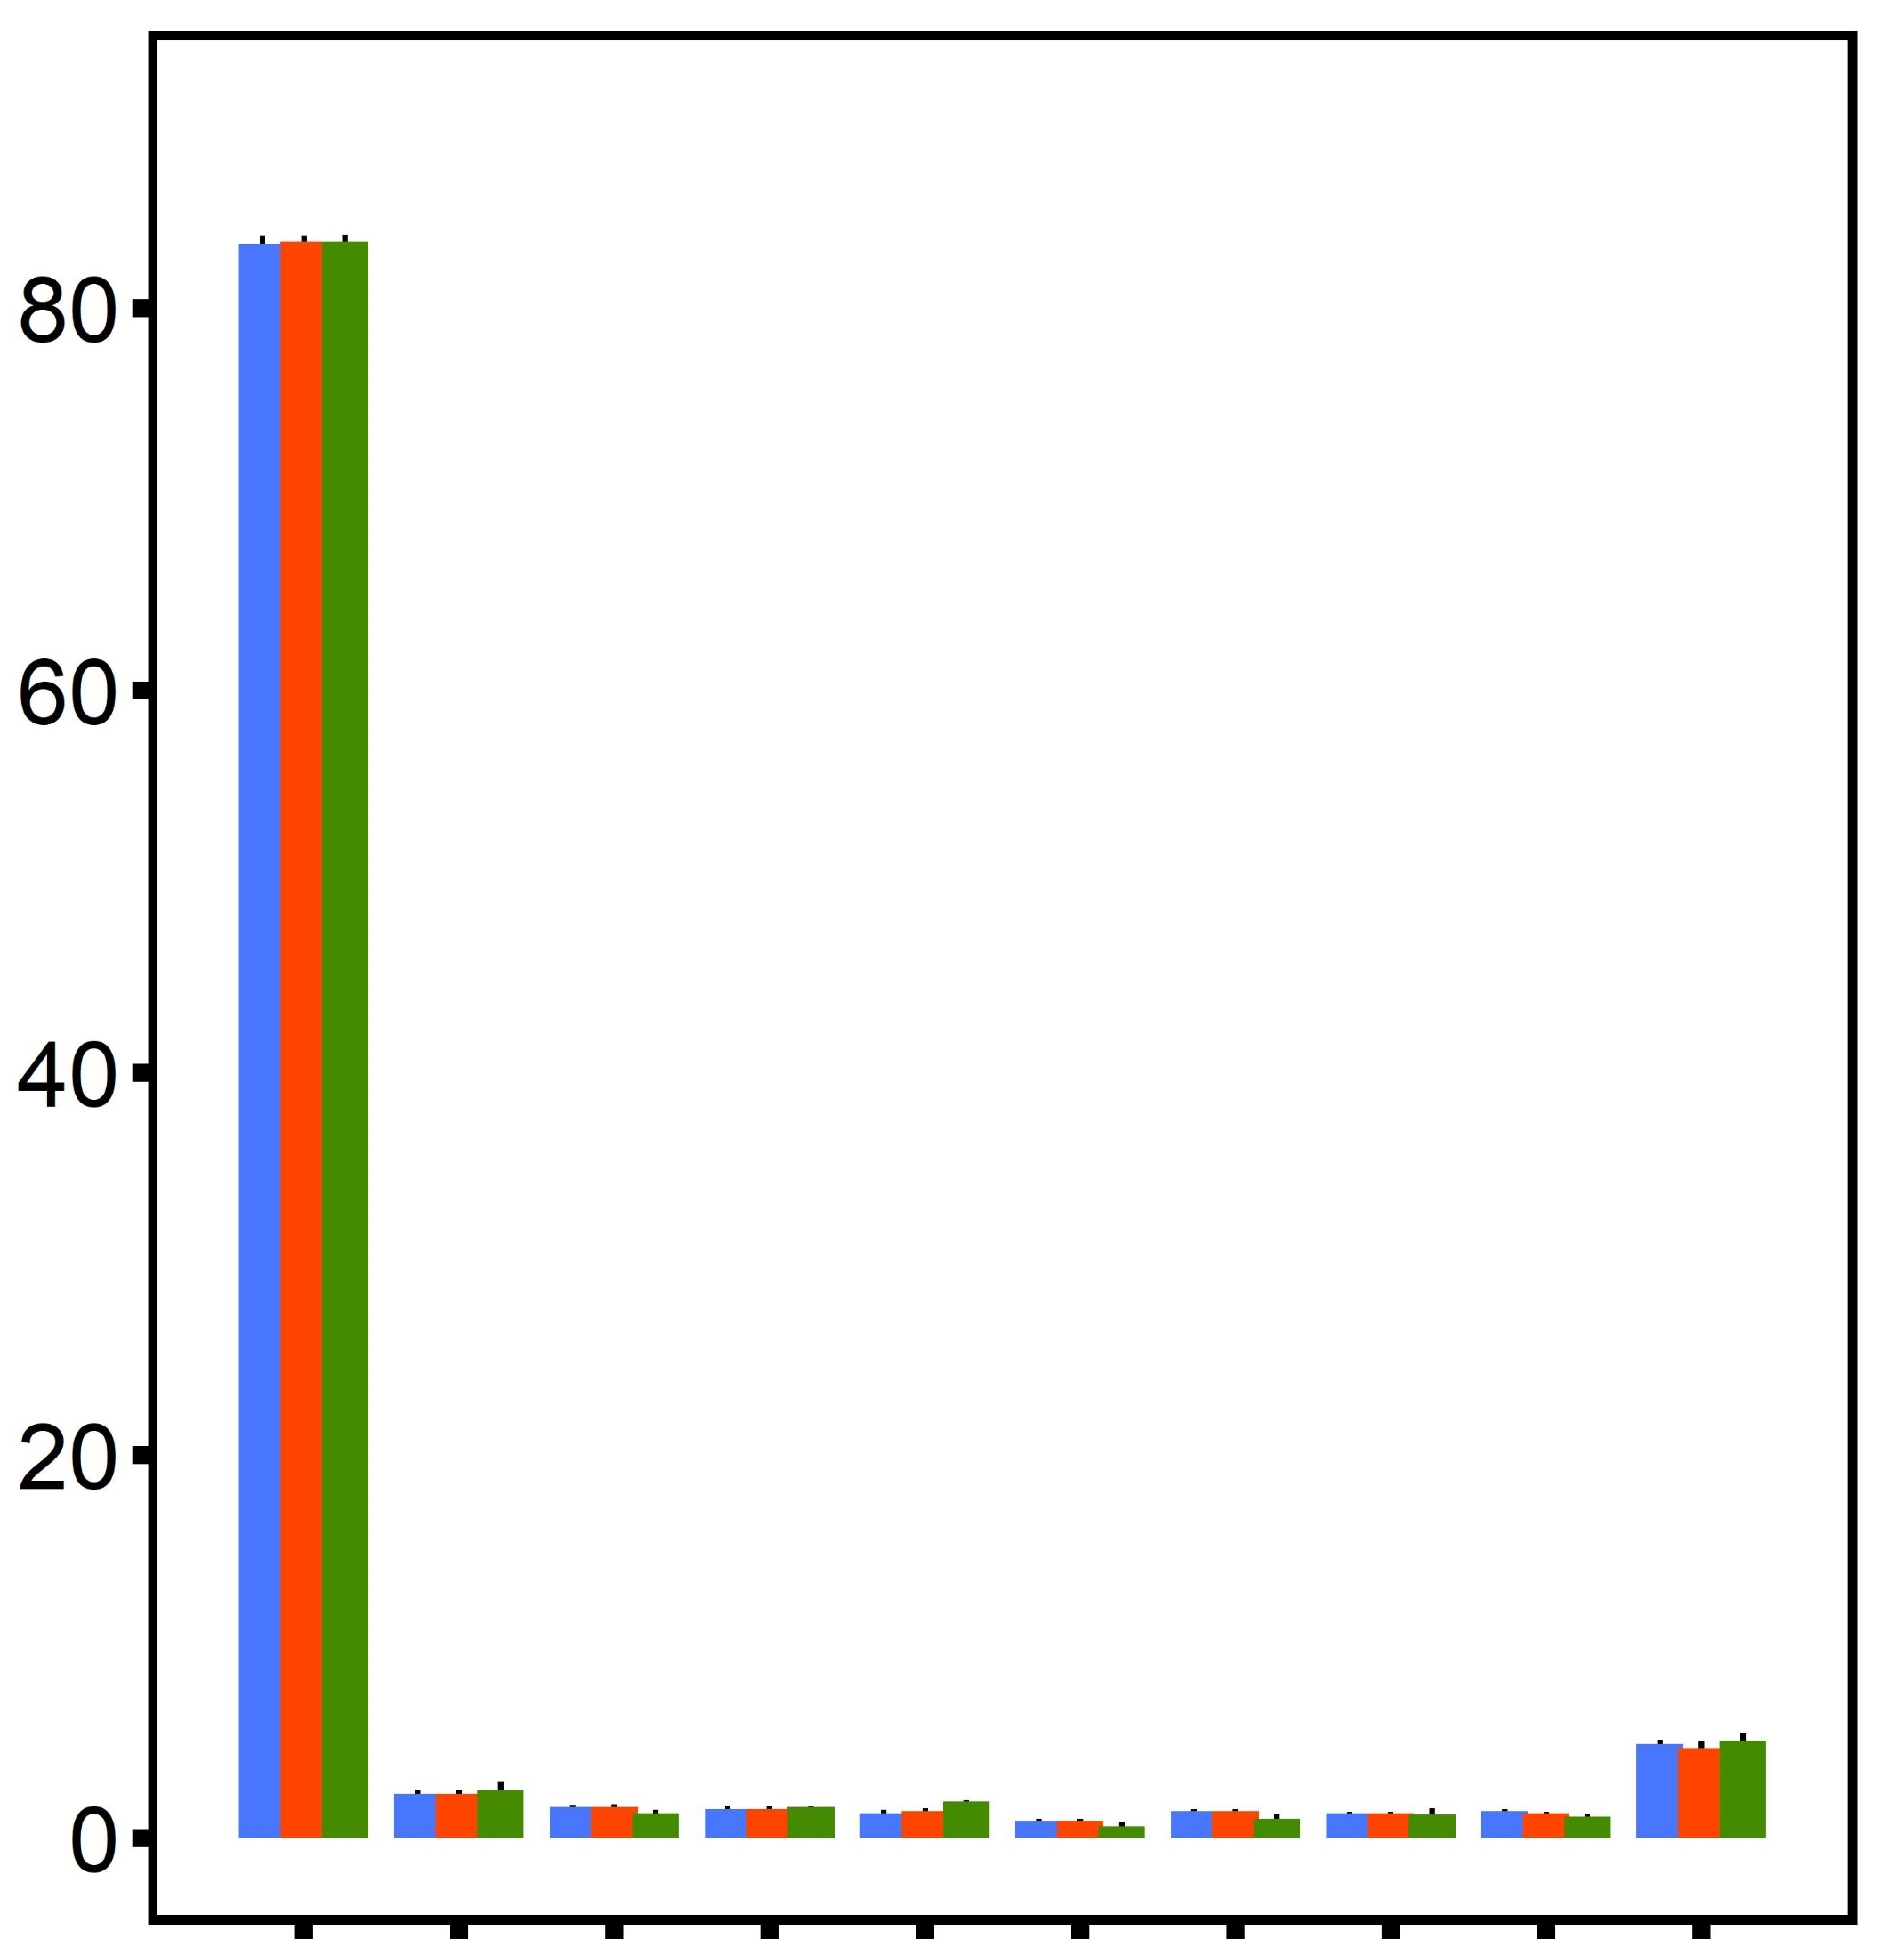
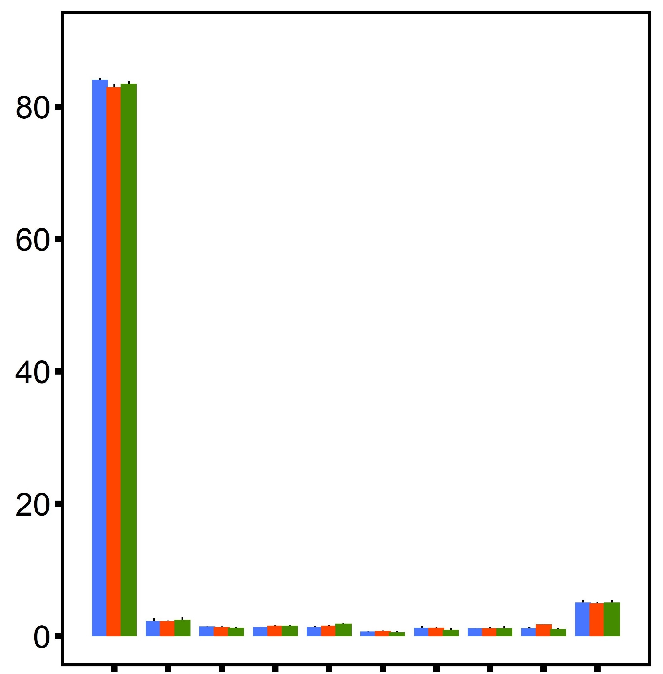
A
B
C
D
diploid
diploid
control
diploid, control
triploid
triploid
desiccation
diploid, desiccation
6×10⁶
control
all samples
all samples
1500
triploid, control
desiccation
triploid, desiccation
all samples
1000
4×10⁶
Frequency (x10⁵)
Frequency (x10⁵)
CpG Loci
PC 2 (6.9%)
500
2×10⁶
0
0
-500
0-10
0-10
-500
0
500
1000
1500
11-20
21-30
31-40
41-50
51-60
61-70
71-80
81-90
11-20
81-90
21-30
31-40
41-50
51-60
61-70
91-100
71-80
91-100
Coverage (x)
Methylation per base (%)
Methylation per base (%)
PC 1 (8.4%)

Slide 2
A
B
C
D
ploidy
ploidy
20% difference
20% difference
desiccation
desiccation
interaction
interaction
20
10
10
DML
Hyper-methylated DML (%)
PC 2 (8.8%)
PC 2 (7.8%)
0
0
-10
-10
-20
diploid
-20
control
triploid
desiccation
-20
-10
0
10
-20
-10
0
10
20
difference threshold (%)
difference threshold (%)
PC 1 (24.0%)
PC 1 (25.4%)
E
Ploidy-DML
F
Desiccation-DML
G
Interaction-DML
100
80
60
40
20
0

Slide 3
A
Genome Feature
B
Exon UTR
CDS
Introns
Upstream Flank
Genes
Downstream Flank
% CpGs
lncRNA
TE
Intergenic
DML
DML-association
Interaction (hyper)
Interaction (hypo)
Desiccation (hyper)
Desiccation (hypo)
All CpG (480,579)
ploidy-DML
(1038)
desiccation-DML (2351)
Interaction-DML (200)
Interaction
-DML, hypo (28)
Interaction
-DML, hyper
(49)
Interaction
-DML, contrast
(123)
Ploidy (hyper)
Chromosome
Ploidy (hypo)

Slide 4
A
ploidy-DML
B
desiccation-DML
C
interaction-DML

Slide 5
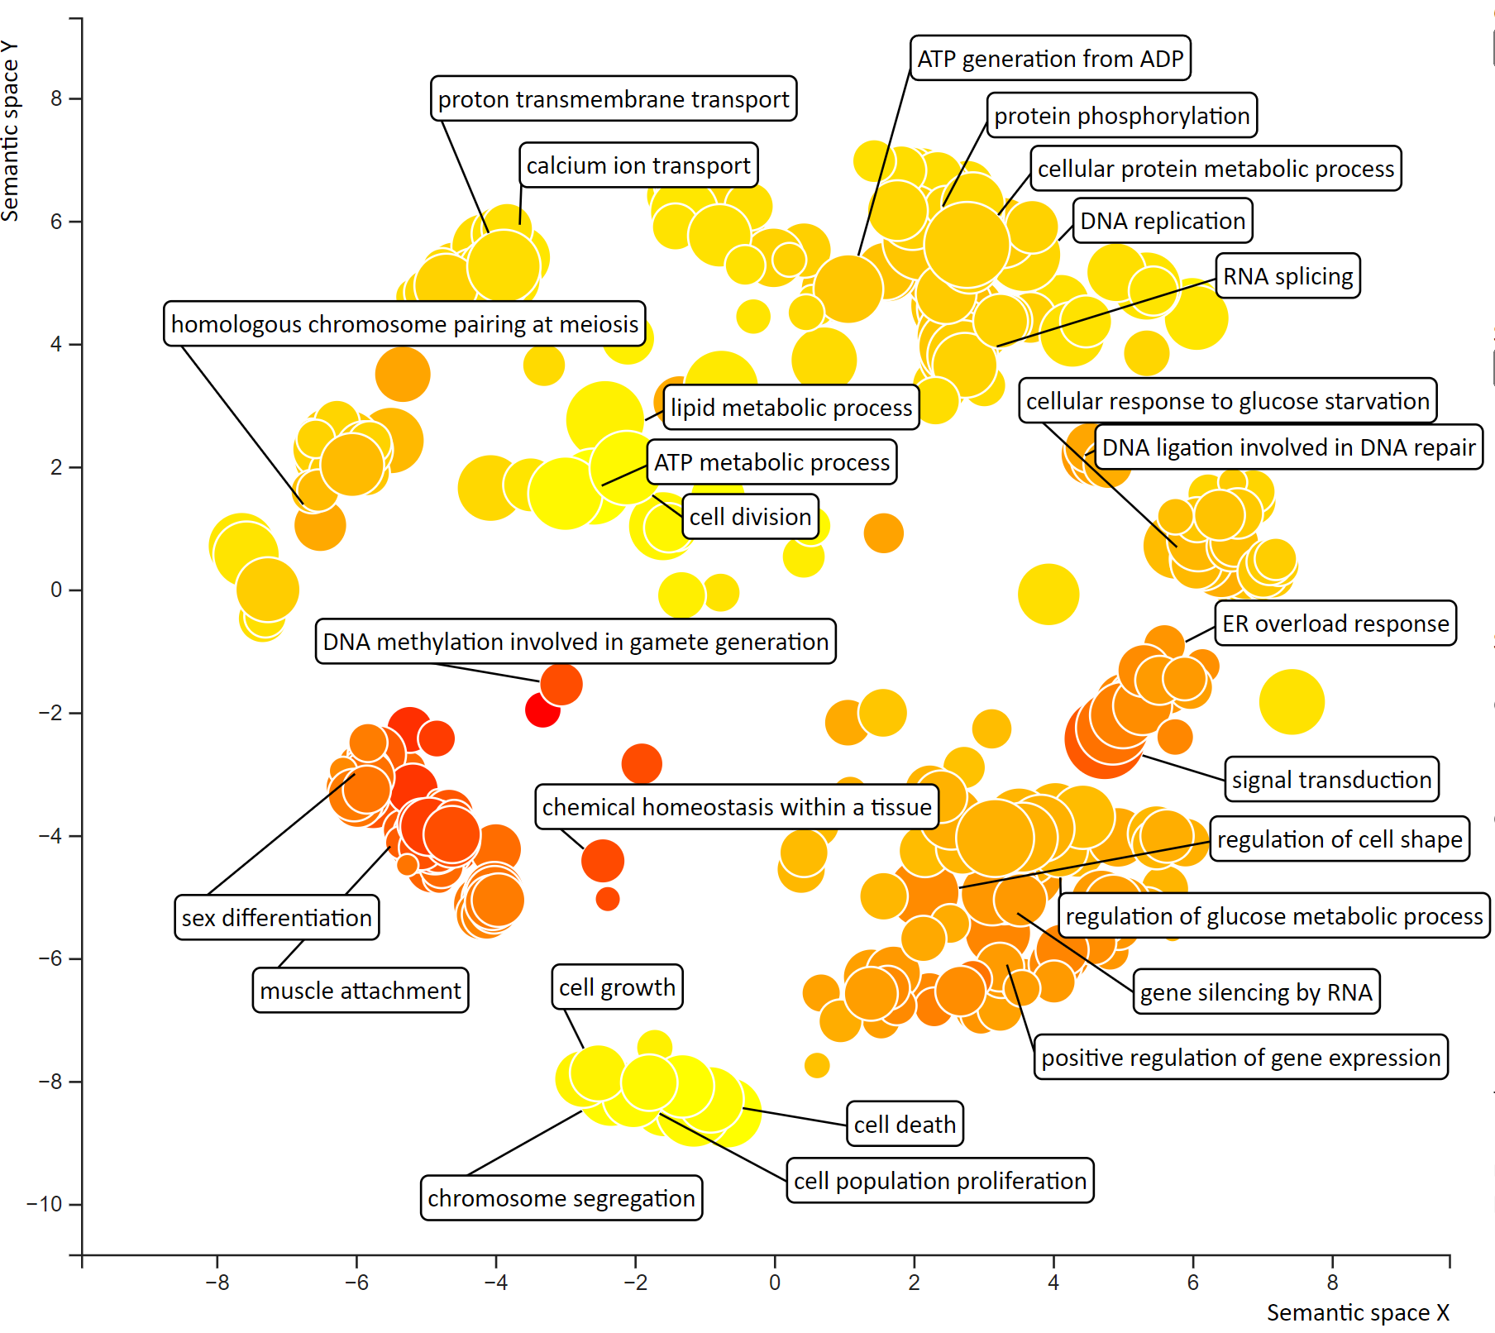
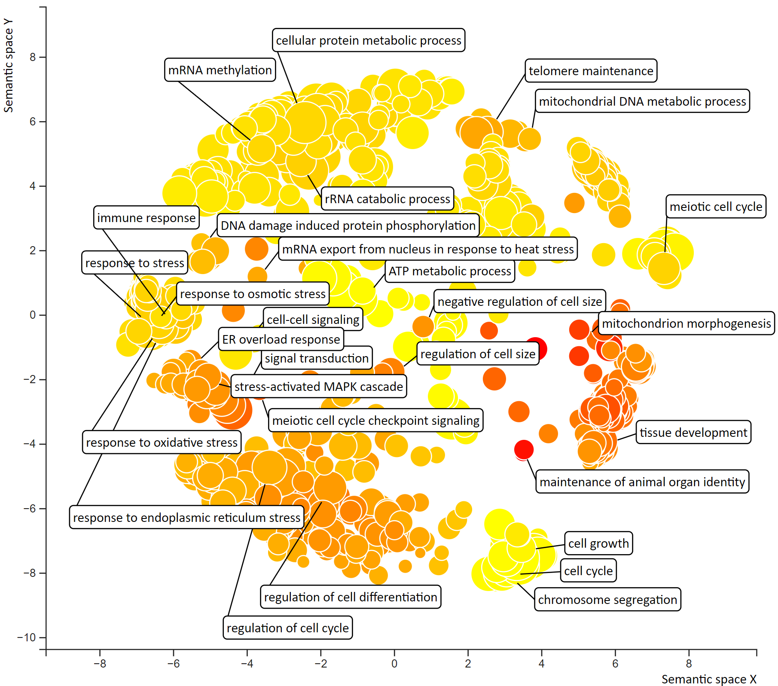
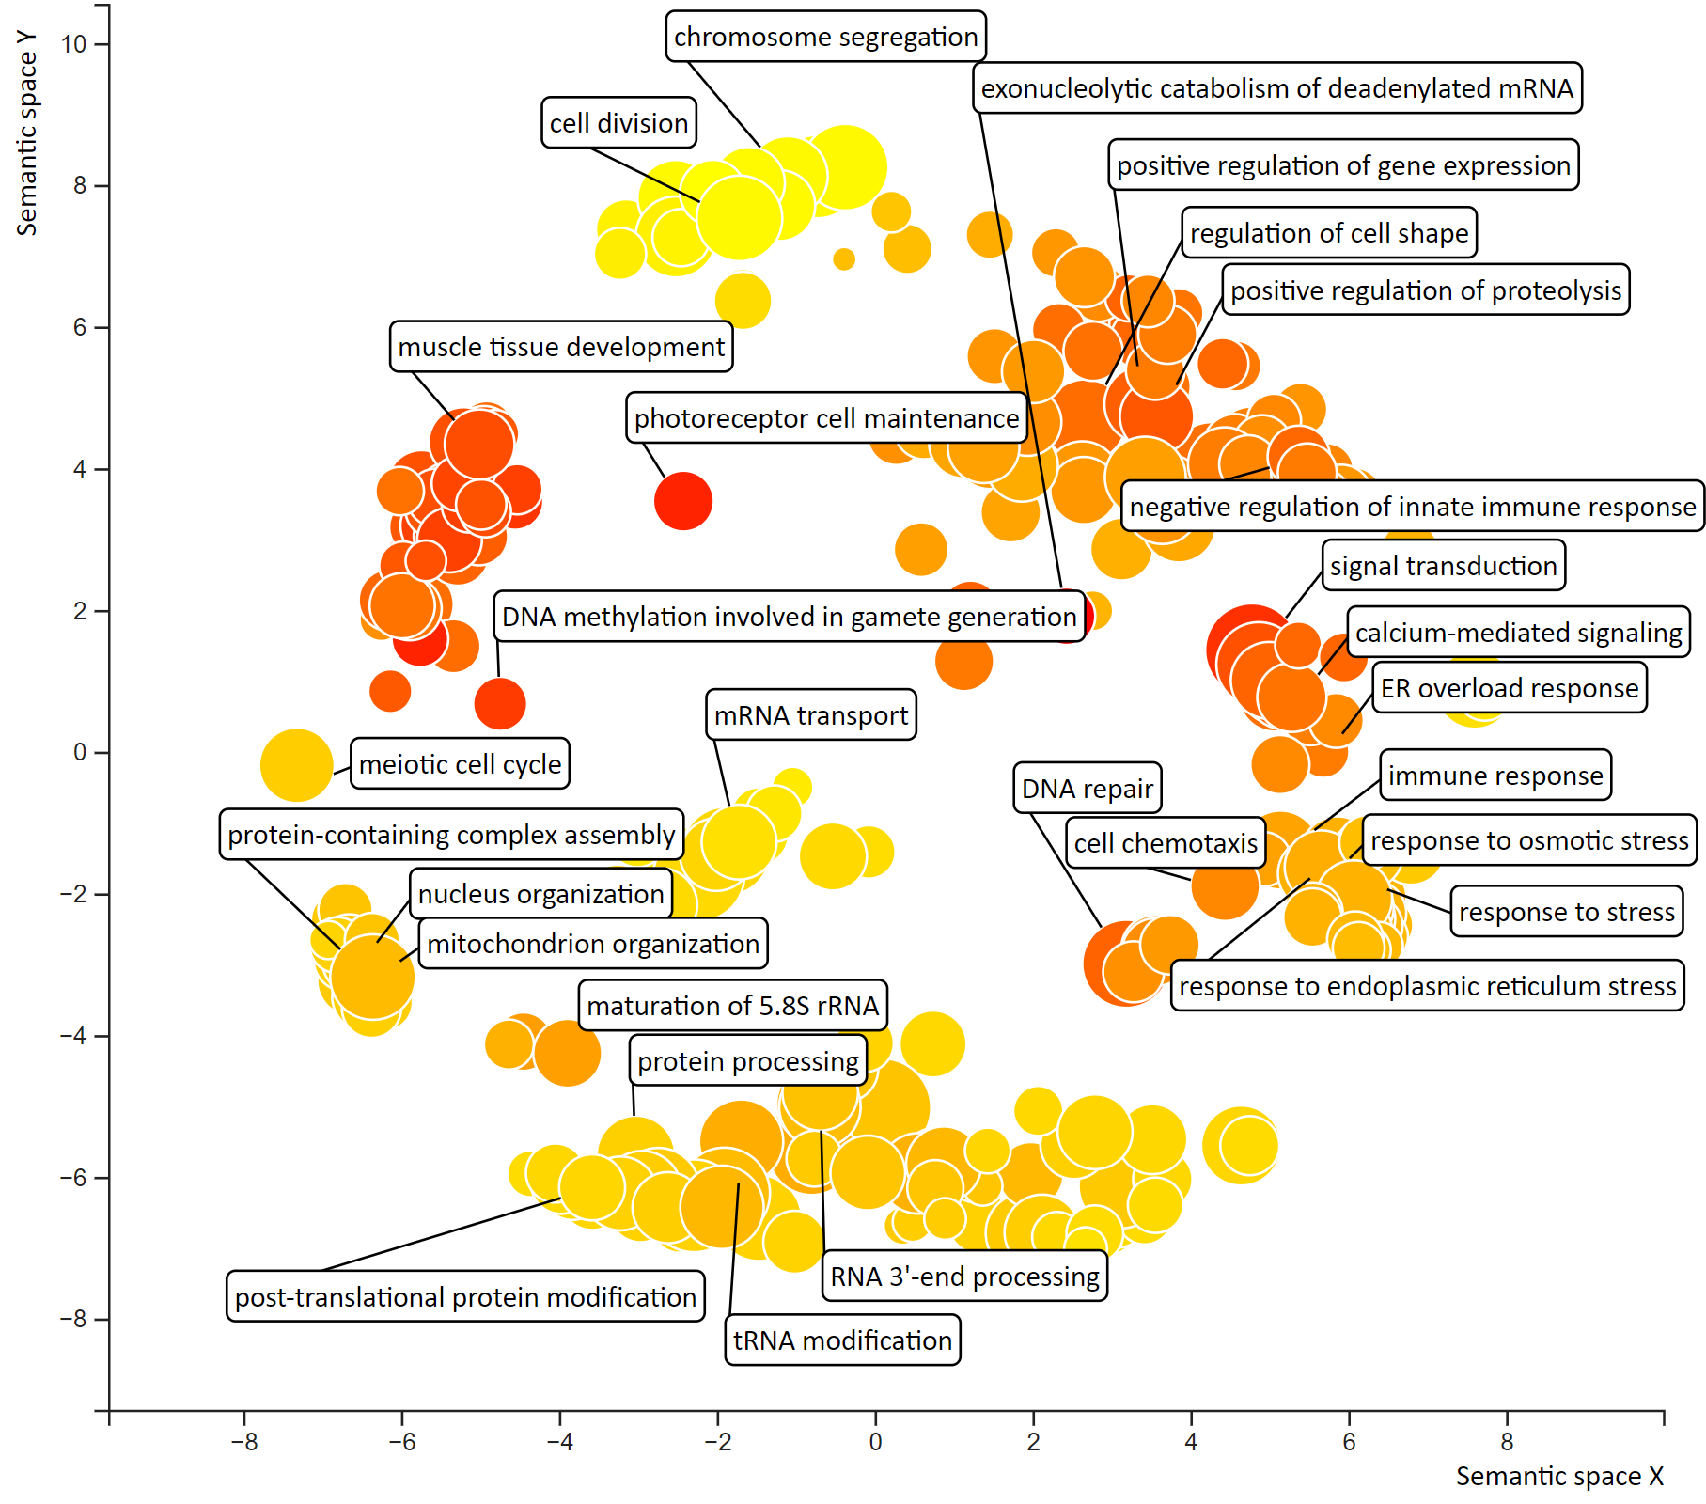
A
ploidy
B
desiccation
C
interaction

