Slide 1
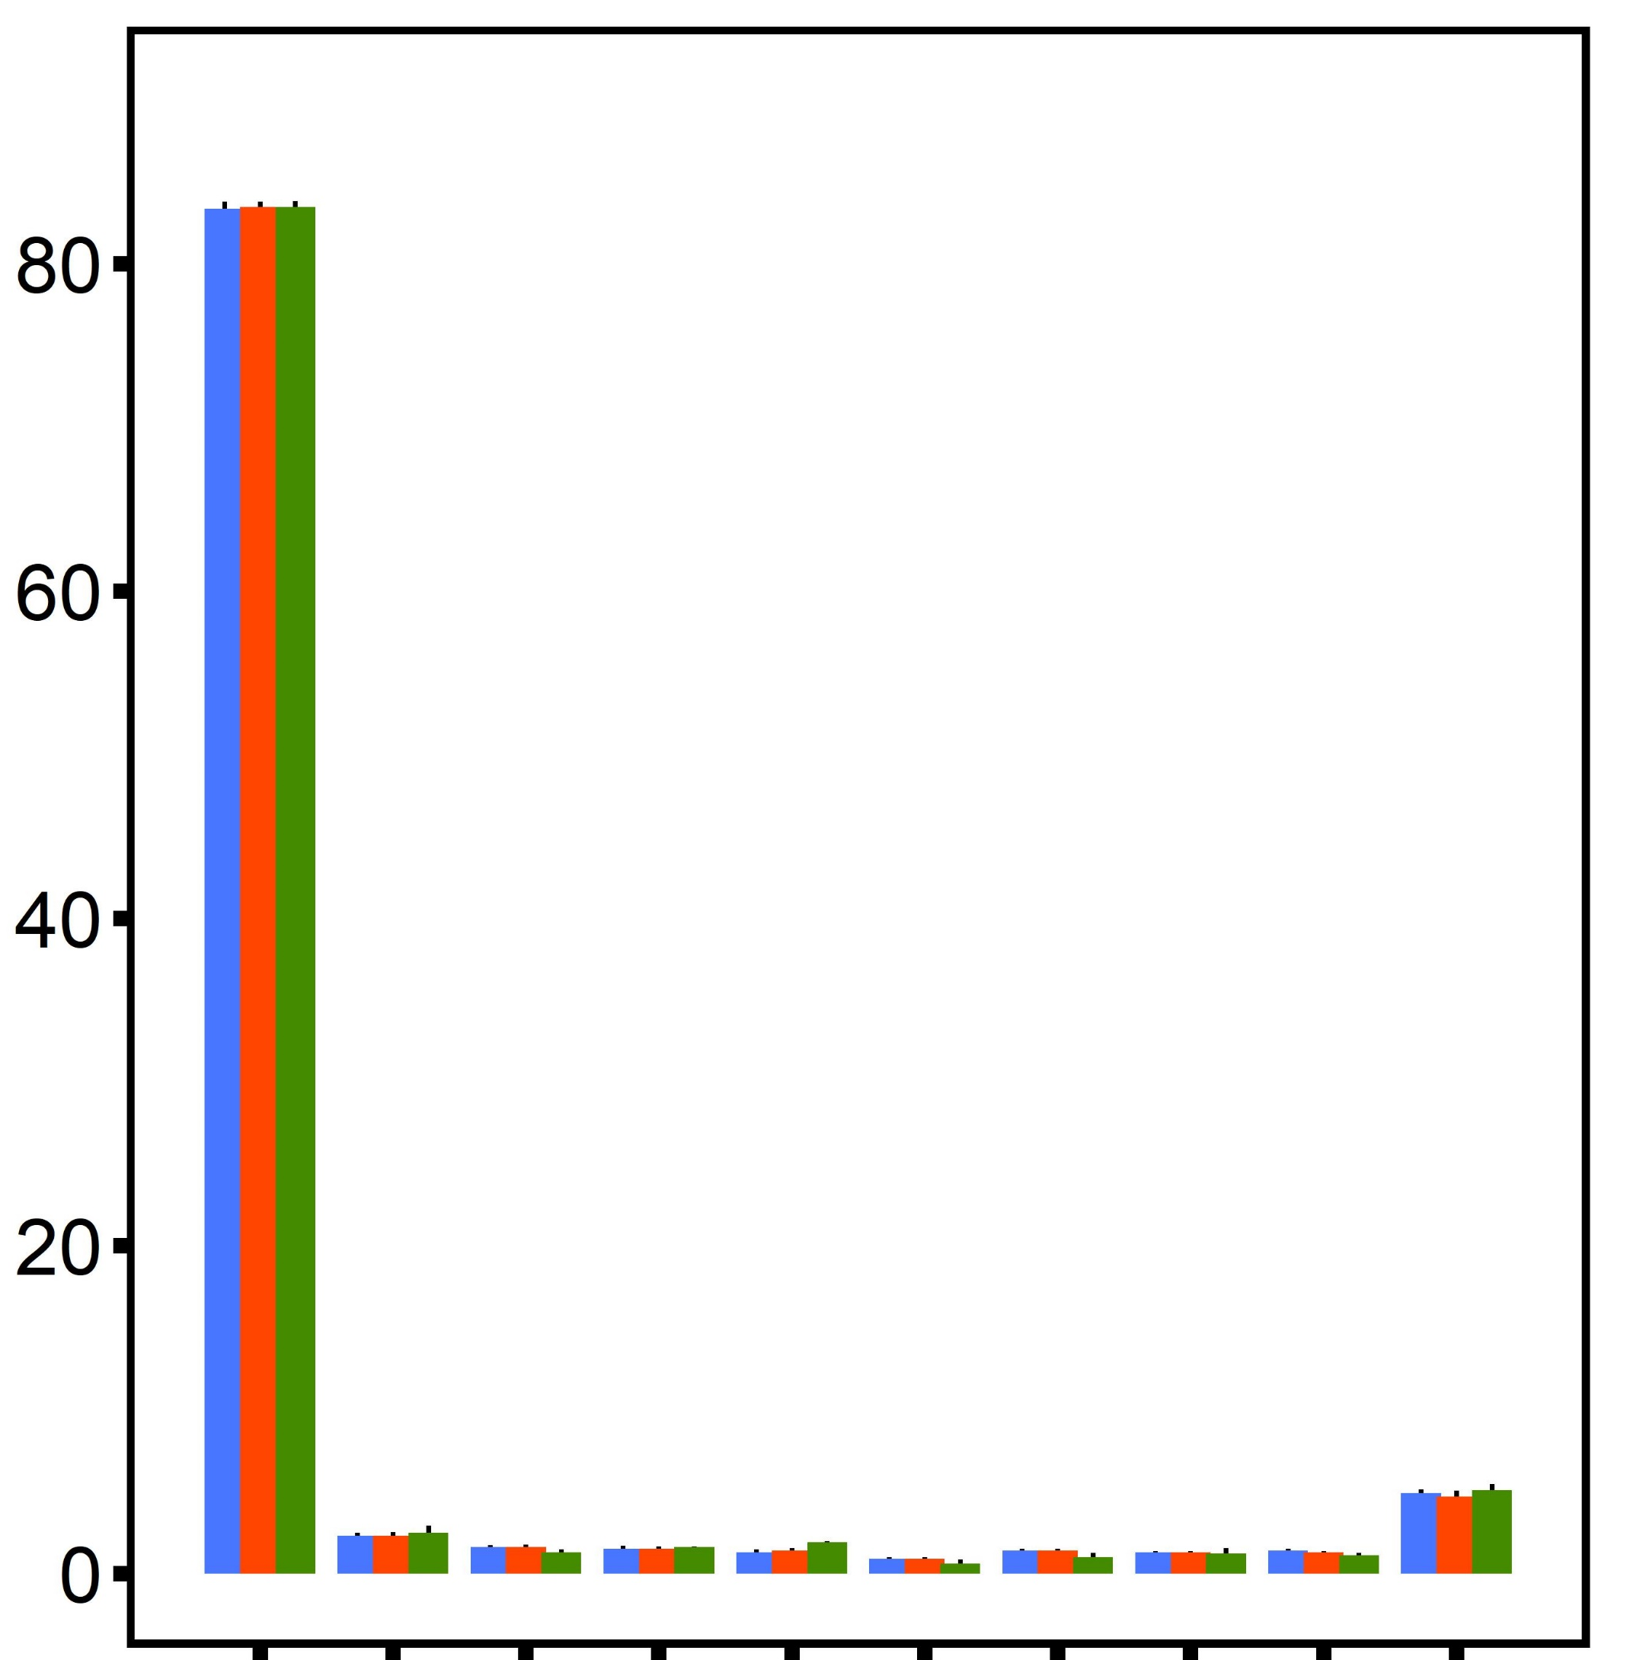
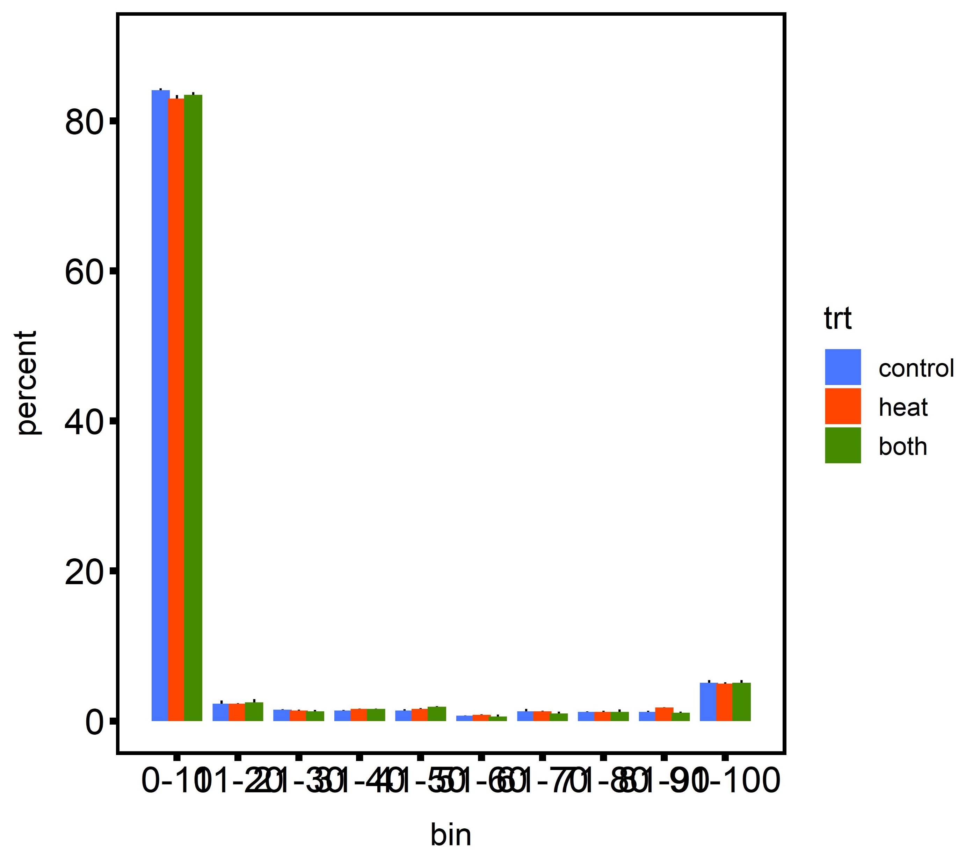
A
B
diploid
diploid
triploid
triploid
6×10⁶
control
all samples
desiccation
all samples
Number of CpG Loci
4×10⁶
Frequency (x10⁵)
2×10⁶
0
0-10
11-20
21-30
31-40
41-50
51-60
61-70
71-80
81-90
91-100
Coverage (x)
Methylation per base (%)
C
D
control
1500
diploid, control
desiccation
diploid, desiccation
all samples
triploid, control
1000
triploid, desiccation
Frequency (x10⁵)
PC 2 (6.9%)
500
0
-500
0-10
11-20
21-30
31-40
41-50
51-60
61-70
71-80
81-90
91-100
-500
0
500
1000
1500
Methylation per base (%)
PC 1 (8.4%)

