Slide 1
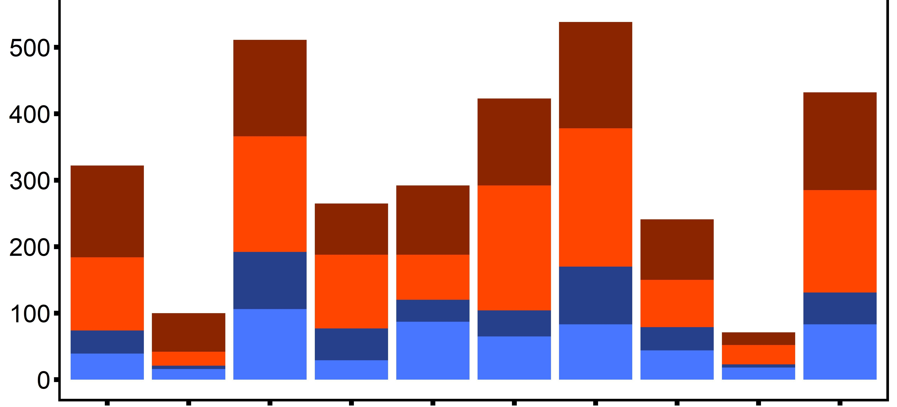
Number of Genes
DML
Desiccation (hyper)
Number of DML
Desiccation (hypo)
Ploidy (hyper)
Ploidy (hypo)
1 2 3 4 5 6 7 8 9 10
Chromosome

