Slide 1
Physiological Markers Associated with Byssus Attachment Following Environmental Perturbations in Marine Mussels
Henry Berg

Slide 2
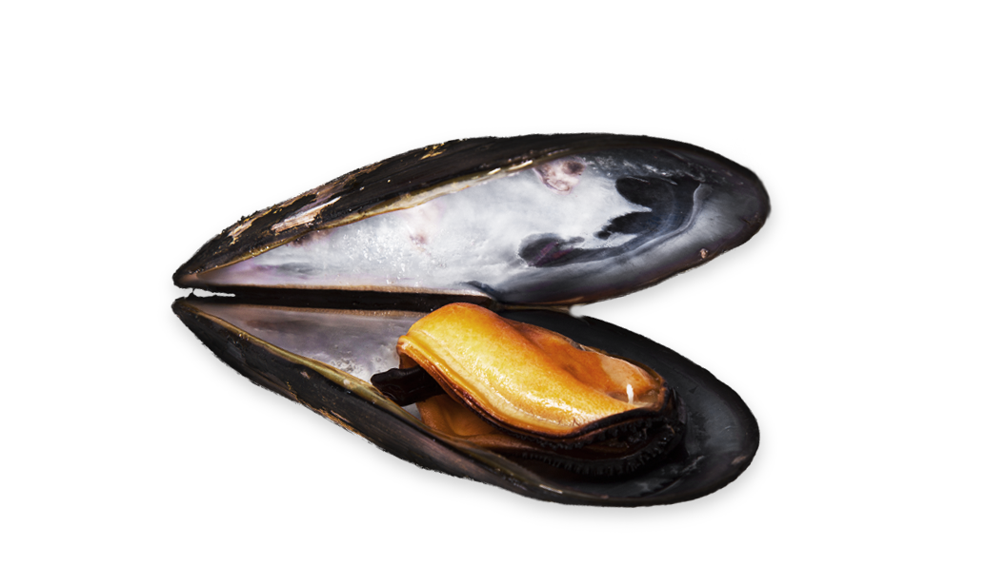
Global bivalve aquaculture value: $20.6B USD/year.
Foundational Mussel Knowledge
Mussels: 13% of global market for US seafood trade.

Slide 3
Mussels attach using protein-based byssal threads
DOPA-rich mussel foot proteins (Mfps) critical for adhesion
Thread production = survival, growth, aquaculture yield
All
About
Biology!

Slide 4
OA → Seawater pH decline due to rising CO2
OW → ~0.9°C increase over 40 years
Hypoxia → Coastal oxygen declines from eutrophication, warming
Climate Change VS Mussels

Slide 5
Let’s Solve The Problem!
Investigate byssal thread production & metabolic performance
Compare two species: Mytilus trossulus & Mytilus galloprovincialis
Examine stressor effects: OA, OW, hypoxia

Slide 6
Previous Studies Show..
Reduced thread production
What Does Science Already Know?
Adaptive Potential
Some proteins are upregulated in resilient mussels.

Slide 7
Hypothesis
Stress affects thread composition, structure, and performance.

Slide 8
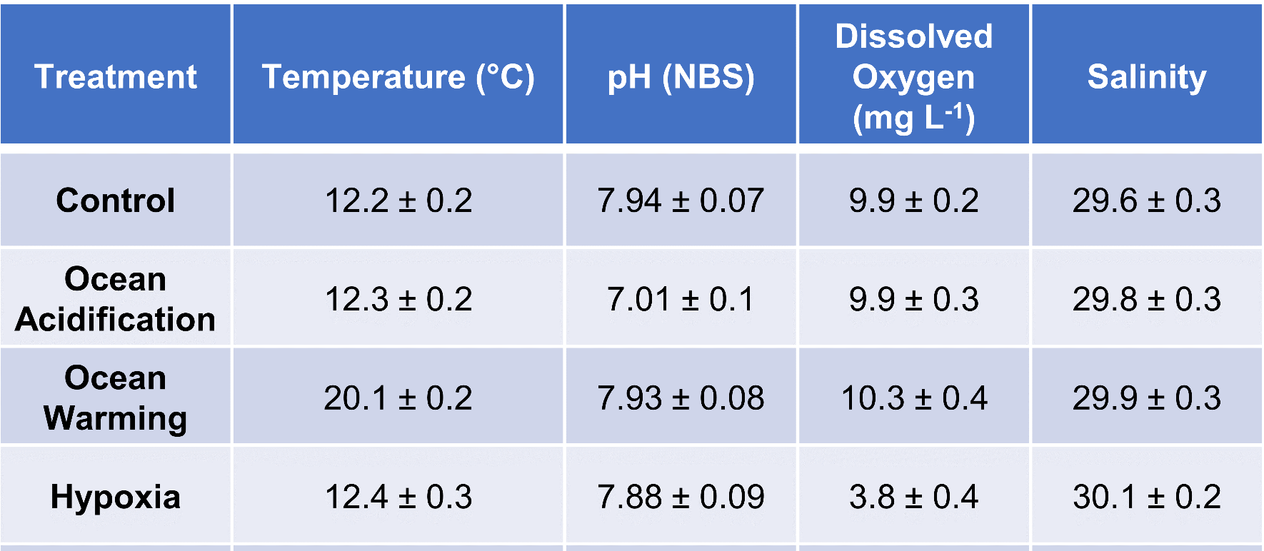
Experimental Design
200 mussels per species collected from Washington farms, acclimated, then exposed to 4 treatments

Slide 9
1
Mussels placed on mica plates for standardized adhesion
Mesocosm tanks with temperature, pH, O2 control
Threads counted before/after stress exposure
The Setup!!
2
3

Slide 10
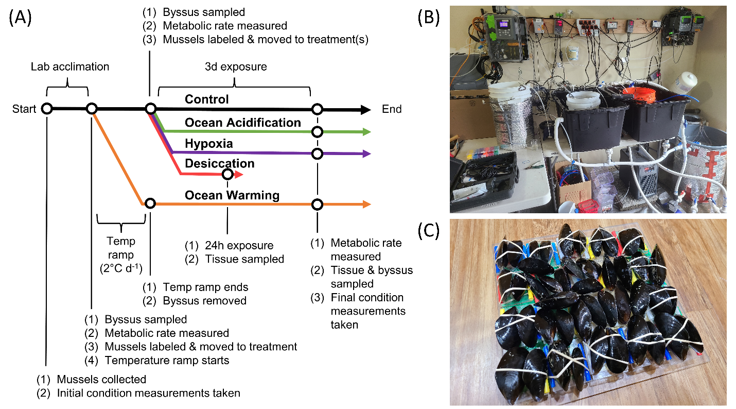

Slide 11
Closed-system respirometry measured SMR
Oxygen uptake (mg O2 h⁻¹ l⁻¹)
Pre- and post-treatment measures
Controlled for temp, salinity, blank chamber
Respiratory Methods

Slide 12
ANOVA & repeated-measures ANCOVA
Tukey’s HSD for pairwise comparisons
Normality checked (Q-Q plots)
Data normalized if/when needed
What Do The Statistics Mean?

Slide 13
What Outcomes Did We Expect?
1
2
3
4
Identification of physiological markers for OA/OW resilience.
Insights for improving mussel farming sustainability.
Contribution to combating the seafood trade deficit.
Physiological markers can enhance industry resilience.

Slide 14
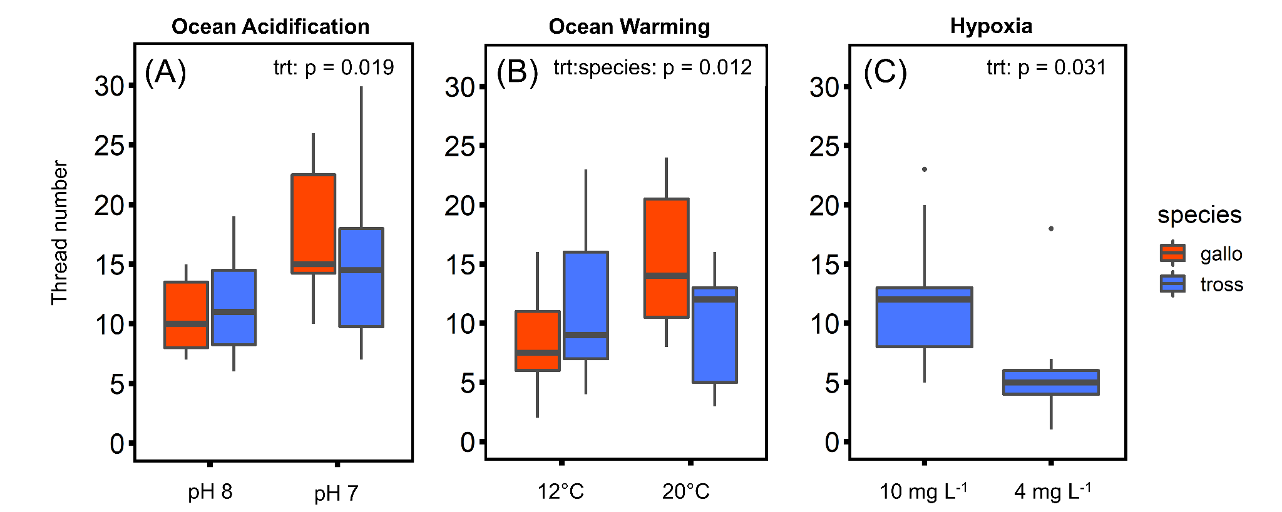
OA: Increased thread production (both species)
OW: Greater production in M. galloprovincialis
Hypoxia: Reduced output in M. trossulus, near-zero in M. galloprovincialis
Let’s Talk Thread Production!

Slide 15
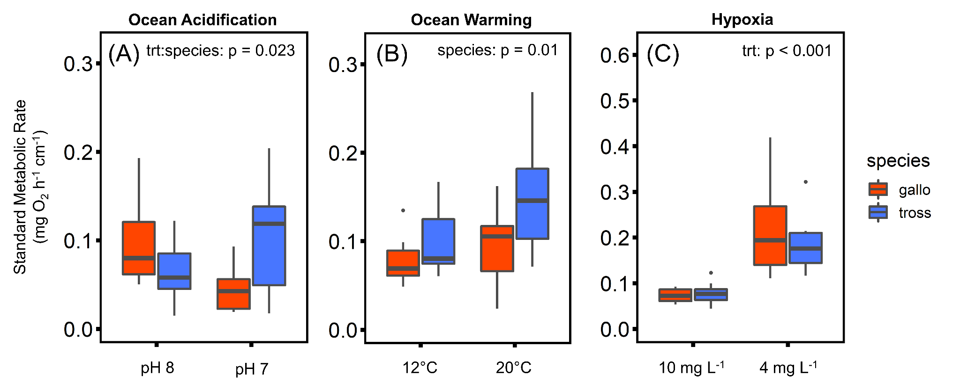
OA: SMR decreased in M. galloprovincialis, increased in M. trossulus
OW: SMR increased in both
Hypoxia: Highest SMR spike in both
Let’s Talk Metabolic Rate!

Slide 16
Understanding climate resilience is important to successful harvest
Why Is This Important For Aquaculture?
Site selection should consider species-specific tolerance
M. galloprovincialis may be more robust under OA/OW
Hypoxia remains a major stressor for both

Slide 17
Limits & Future Recommendations
→ Acute exposure (3 days): How do chronic stress responses differ?
→ Mechanistic studies on Mfp expression, byssus chemistry
→ Application to selective breeding, site management

Slide 18
Key Takeaways
Climate change stressors impact mussel physiology
Species specifics are significant
Aquaculture should leverage physiological insights and practice resilience-based farming

Slide 19


The Team
Matt George, Ph.D
Steven Roberts Ph.D
Work Site Supervisor
Advisor

Slide 20

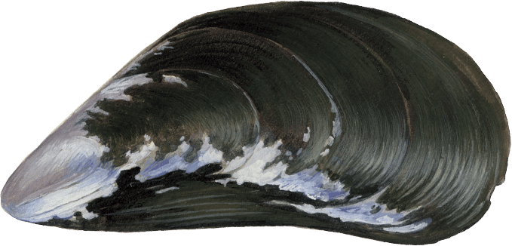
Thanks For Listening!

Slide 21

Any Questions?

