Slide 1
Effects of salinity and ocean acidification stress on Pacific oyster (Magallana gigas) thermal tolerance
Genevieve Buchanan
Spring 2025

Slide 2
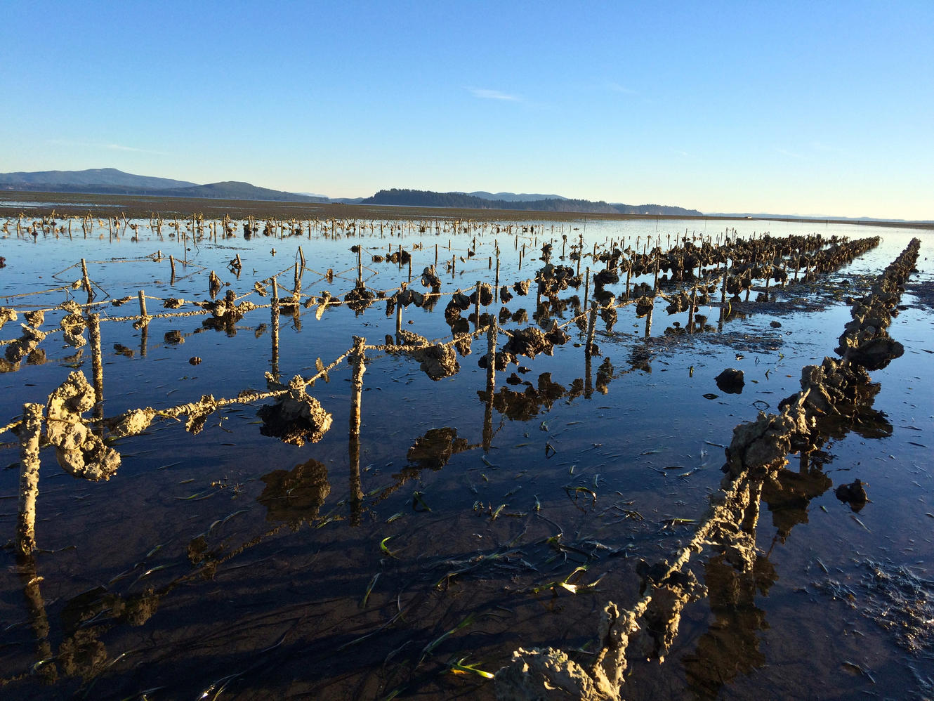
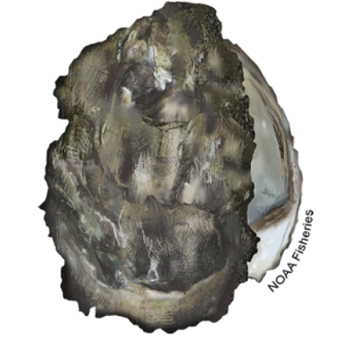
Oysters are ecologically and economically important
Magallana gigas (Pacific oyster)
(NOAA 2015)
(Cascade PBS, 2016)
Notes:
Introduced to the PNW in the early 20th century
Primarily inhabit intertidal and estuarine environments
Most cultivated shellfish species globally (WSG, 2015)
High economic value (270 million dollars annually, shellfish in general)
Provide vital ecosystem services
Summer mortality in oyster aquaculture

Slide 3
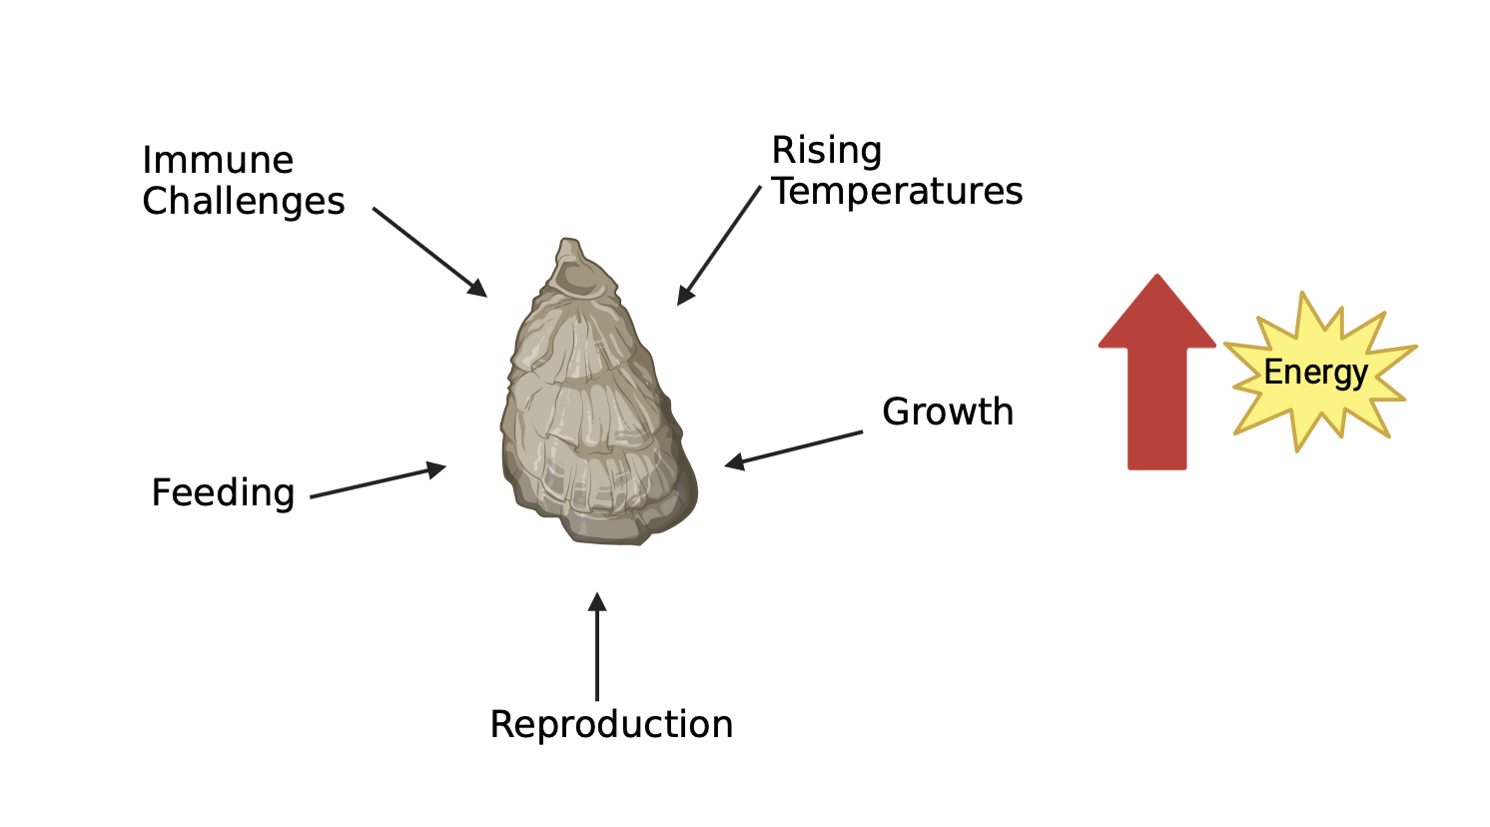
Energy demands lead to summer mortality
20-80% annual loss in harvest
(Pacific Shellfish Institute, 2021)

Slide 4
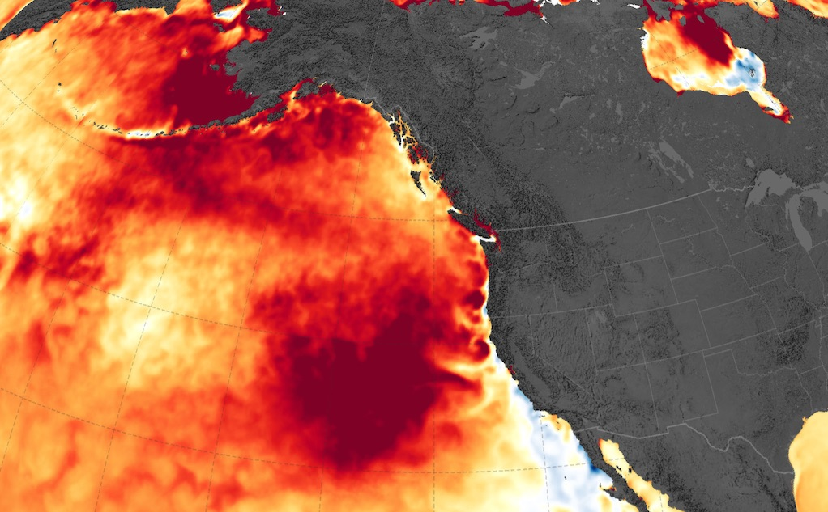
Climate change is increasing summer heat stress
(Encyclopedia of Puget Sound, 2020)

Slide 5
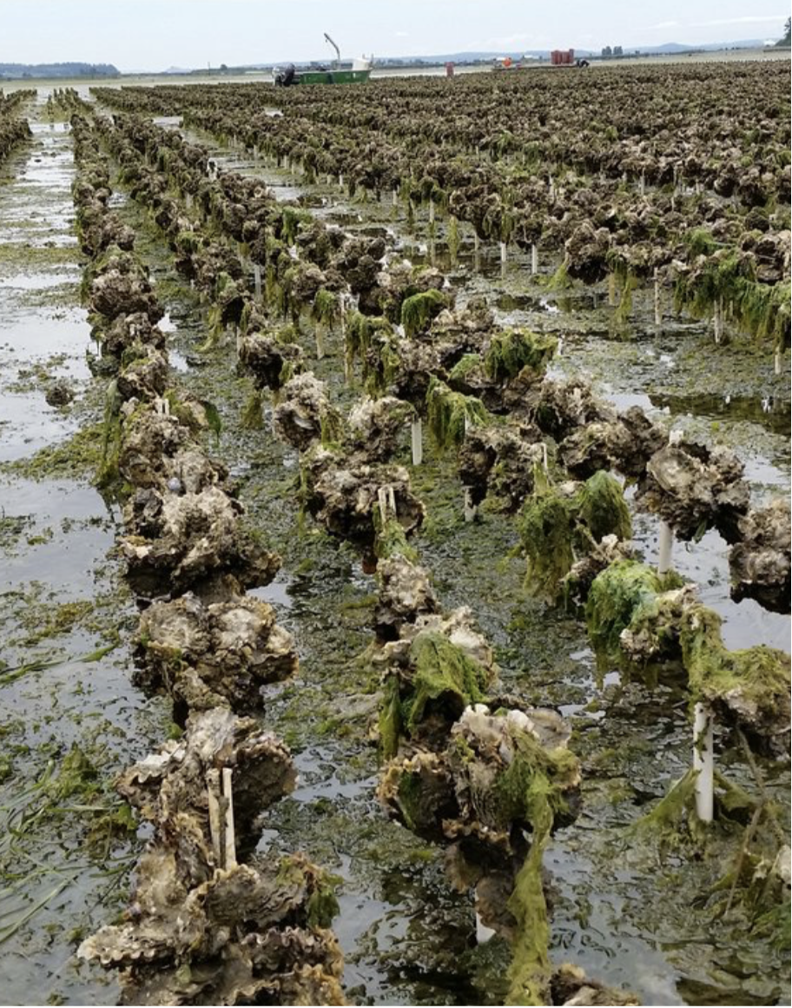
Multiple stressors increase energy demands
Salinity
pH
Temperature
Aerial exposure
(Penn Cove Shellfish)

Slide 6
Multiple stressors increase energy demands
Salinity
pH
Temperature
Aerial exposure
(Penn Cove Shellfish)

Slide 7
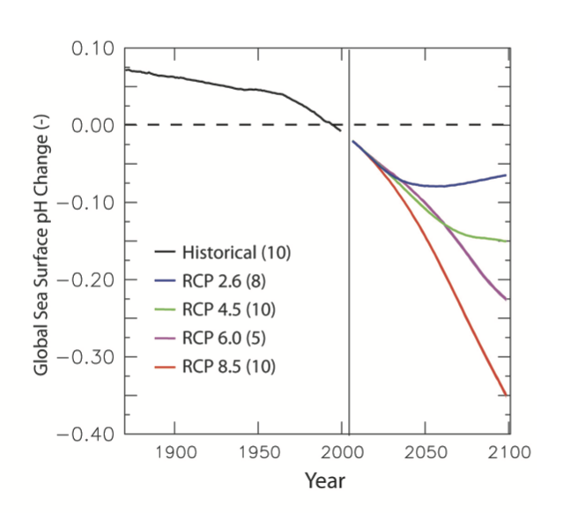
Variability in salinity and OA
(Capitol Land Trust, 2022)
(Bopp et al., 2013)
Notes:
Might increase energy demand, and may exacerbate the effect of elevated temperature. There is a gap in understanding, on how previous environmental stressors may affect tolerance to climate change stressors such as heat waves

Slide 8
Research objectives and hypotheses
Question:
How does exposure to low pH and salinity, affect Pacific oyster survival under subsequent acute thermal stress?
Hypotheses:
H₀ : Prior exposure to low pH and salinity will have no significant effect on Pacific oyster survival under thermal stress
H₁ : Oysters exposed to either salinity or extreme OA stress prior to thermal stress will exhibit decreased survival compared to that of controls
Notes:
Oysters exposed to either salinity or extreme OA stress prior to thermal stress will exhibit decreased survival compared to that of controls, as energy used to combat salinity or OA stress may hinder tolerance to subsequent heat stress

Slide 9
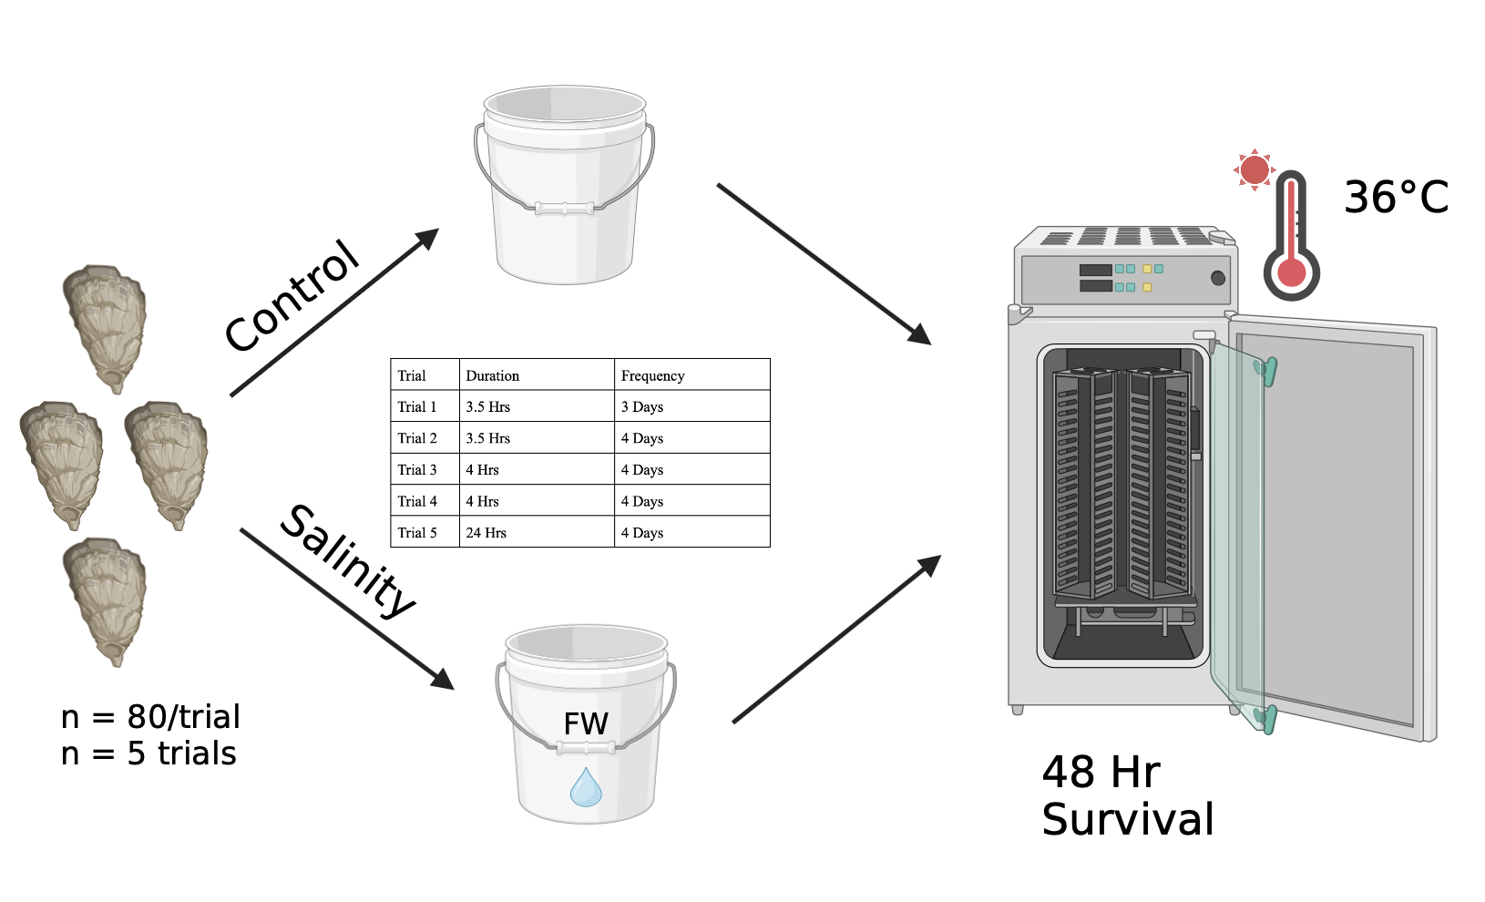
Methods: Salinity Stress
Notes:
Experiment 1: Tested the effects of salinity stress on thermal tolerance
Pacific oyster seed (10-40 mm) obtained from the Jamestown Seafood Point Whitney Shellfish Hatchery (Brinnon, WA)
Temperature (°C), salinity (psu), and pH measurements taken at the start and end of each day of exposure

Slide 10
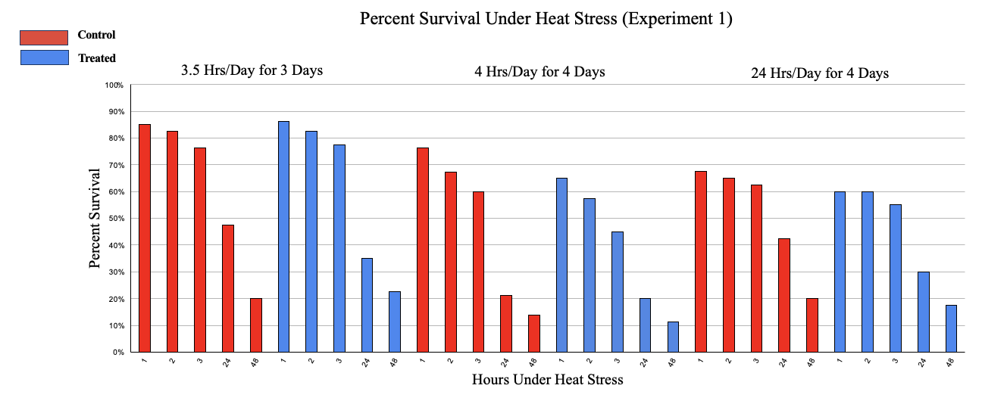
Salinity stress does not impact thermal tolerance
p = 0.967
Notes:
Explain axes, legend, and title

Slide 11
Salinity stress does not impact thermal tolerance
p = 0.967
p = 0.596

Slide 12
Salinity stress does not impact thermal tolerance
p = 0.967
p = 0.596
p = 0.769

Slide 13
Thermal stress greatly reduces survival
p = 0.967
p = 0.596
p = 0.769

Slide 14
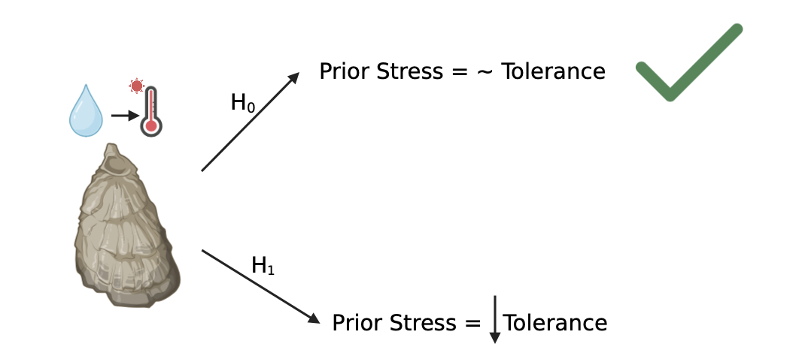
Salinity stress does not impact thermal tolerance
Notes:
No statistically significant difference in thermal tolerance following salinity stress at tested salinity/time scale
Pacific oysters are likely acclimatized to natural salinity fluctuations in the Pacific Northwest
Thus, there was likely no observable physiological stress responses initiated from salinity stress to better tolerate thermal stress
Although these results are not statistically significant, these results suggest that oysters can tolerate these compounding environmental stressors than originally hypothesized

Slide 15
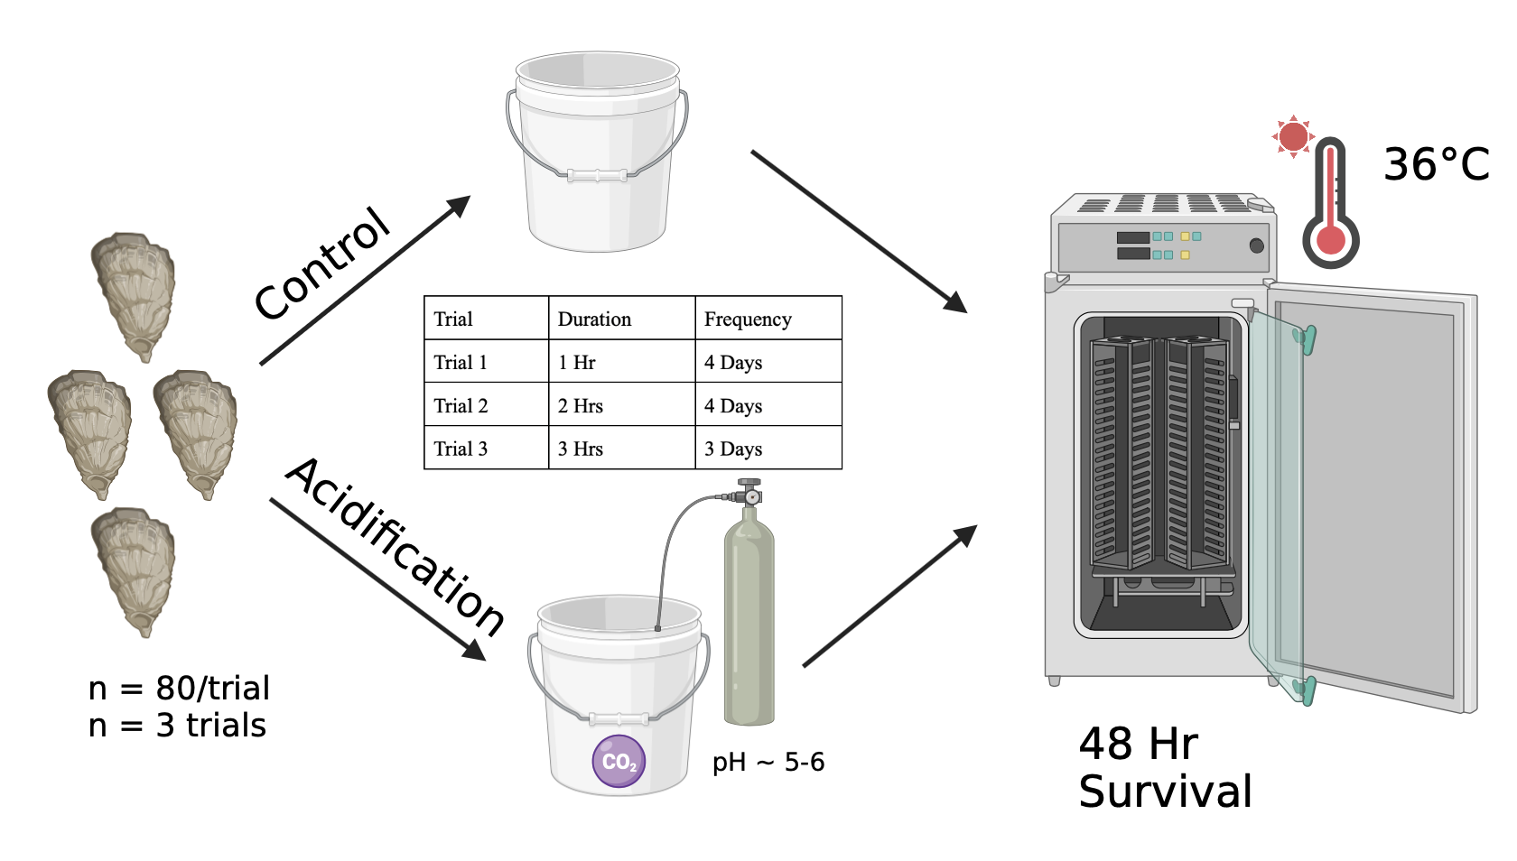
Methods: Acidification Stress
Notes:
Experiment 2: Tested the effects of low pH stress on thermal tolerance
This was an extreme OA stress, but at a short duration, likely would not be experienced in the natural environment

Slide 16
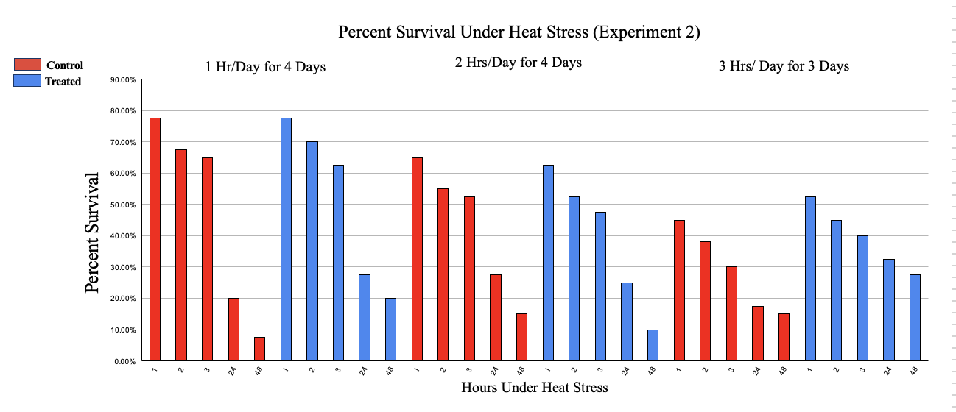
OA stress does not impact thermal tolerance
P>0.05
p = 0.109

Slide 17
OA stress does not impact thermal tolerance
P>0.05
p = 0.109
p = 0.570

Slide 18
OA stress does not impact thermal tolerance
P>0.05
p = 0.109
p = 0.570
p = 0.177

Slide 19
Thermal stress greatly reduces survival
P>0.05
p = 0.109
p = 0.570
p = 0.177

Slide 20
Trend for higher survival in treated oysters
P>0.05
p = 0.109
p = 0.570
p = 0.177
Notes:
Observed trend for higher survival in oysters exposed to OA for 3 Hrs/Day over 3 days (total 9 hours of exposure)
Very interesting at such an extreme time-scale and intensity that we would even see the slightest bit of improved tolerance. May be an area for future research that could potentially aid in buffering the response to thermal stressors in oyster aquaculture

Slide 21
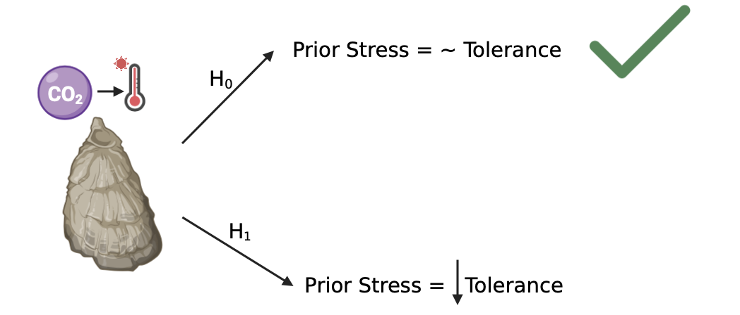
OA stress does not impact thermal tolerance
Notes:
No statistically significant difference in thermal tolerance following acidification stress at tested salinity/time scale

Slide 22
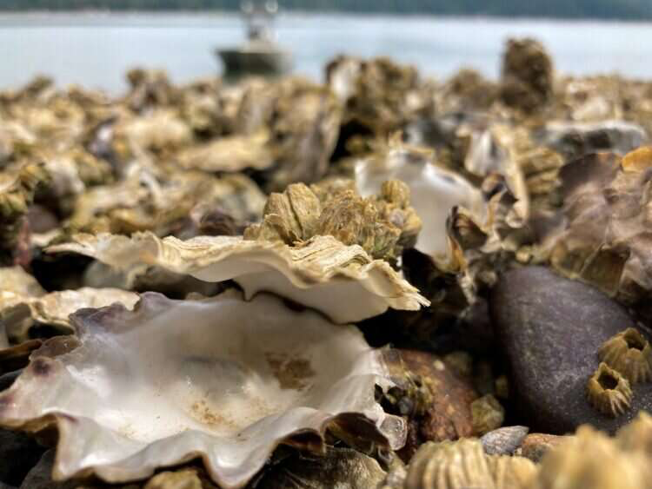
Thermal stress significantly reduced survival in Pacific oysters
(Blair Paul, 2019)
(Encyclopedia of Puget Sound, 2020)
73-87.5% mortality observed in this study
Notes:
Heat stress may be just “too strong” for them to tolerate

Slide 23
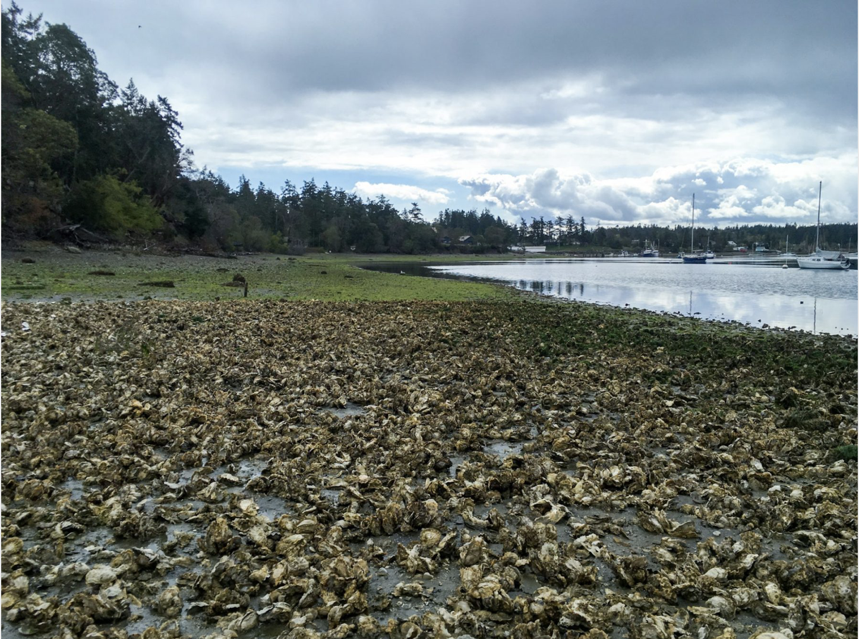
Compounding stressors had no statistically significant effect on oyster survival
(Julieta Martinelli, 2020)

Slide 24
Pacific oysters may be energetically well adapted to naturally variable conditions in the Pacific Northwest
(Cascade PBS, 2016)

Slide 25
Acknowledgements
I would like to considerably thank Dr. Steven Roberts and Ariana Huffmyer for their guidance, recommendations, and thoughtfulness towards this research.
I would also like to thank the Jamestown Seafood Point Whitney Shellfish Hatchery for providing Pacific oyster seed utilized within the Roberts Lab.

